Slide 1

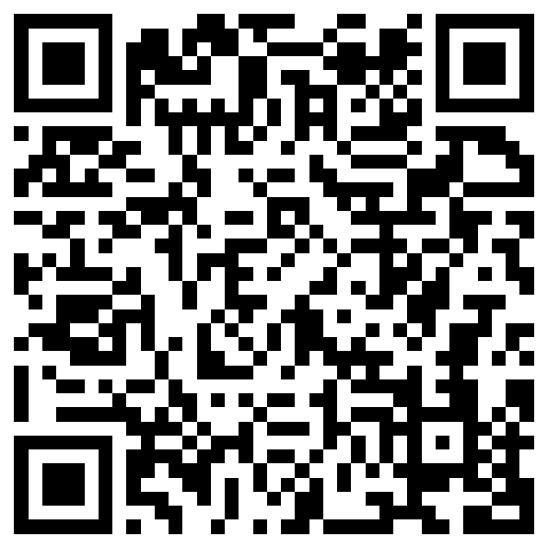
Characterizing uncertainty in lexically triggered inferences
Aaron Steven White
University of Rochester
MindCORE/ILST Seminar
University of Pennsylvania
30 January 2026

Slide 2
Big Question
What kinds of things do we know when we know the meaning (broadly construed) of a linguistic expression?

Slide 3
One Kind of Knowledge
How the expression can move a conversation forward when used in a particular way.

Slide 4
ASSERT
Leo ran the race.
Shared picture of the world
Stalnaker 1974, 1978, i.a.

Slide 5
ASK
Did Leo run the race?
Leo ran the race.
Leo didn’t run the race.
?
?
Shared picture of the world
Hamblin 1973, Karttunen 1977, i.a.

Slide 6
One Kind of Knowledge
How the expression can move a conversation forward when used in a particular way.
Another Kind of Knowledge
How the conversation has to look for it to even make sense to use the expression.

Slide 7


Leo ran the race.
Shared picture of the world
Strawson 1950, i.a.; cf. Russell 1905
e.g. Heim 1982, Kamp and Reyle 1993

Slide 8
Did Leo run the race?
Leo ran the race.
Leo didn’t run the race.
?
?
Shared picture of the world
Strawson 1950, i.a.; cf. Russell 1905
e.g. Heim 1982, Kamp and Reyle 1993

Slide 9
Surprising Fact
Sometimes we don’t seem to know whether particular expressions make sense in a certain kinds of conversation.

Slide 10
Leo won the race.
Participation is a precondition of winning
If Leo won he must have participated
Leo ran in the race.

Slide 11
Did Leo win the race?
Did he even run in it?
Projective
inference
?
Leo ran in the race.

Slide 12
Surprising Fact
Sometimes we don’t seem to know whether particular expressions make sense in certain kinds of conversations.
Question
What is this uncertainty uncertainty about?

Slide 13
Possibility #1
It’s sort of like lexical ambiguity.

Slide 14
Leo ran the race.
Leo ran in the race.

Slide 15
Stride quickly
Direct activity
Uncertainty must be resolved on particular occasions of use to determine speech act’s content.
Leo ran the race.
?
Leo ran in the race.

Slide 16
Possibility #1
It’s sort of like lexical ambiguity.
Possibility #2
It’s sort of like vagueness.

Slide 17
Leo ran a marathon in 3:40.
?
Leo’s marathon was fast.

Slide 18
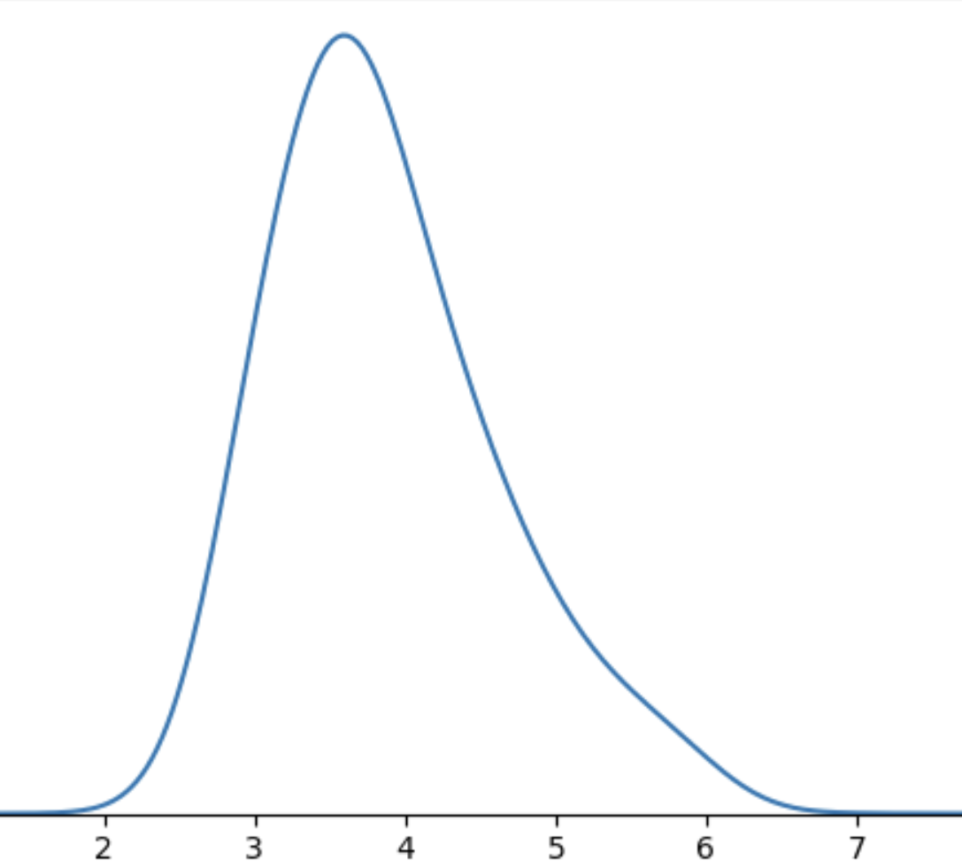
Uncertainty generally remains unresolved on particular occasions of use but speech act nonetheless has clear content.
Leo’s marathon

Slide 19
Possibility #1
Resolved Uncertainty
Uncertainty about an expression and/or context of use that tends to be resolved on particular occasions of use.
It’s sort of like lexical ambiguity.
Unresolved Uncertainty
Possibility #2
It’s sort of like vagueness.
Uncertainty about an expression and/or context of use that is manifest on all occasions of use.

Slide 20
Conventional + Conversational
Purely Conversational
Ambiguity
Resolved Uncertainty
Uncertainty across multiple distinct semantic values for an expression that have different preconditions of use.
Uncertainty across possible discrete states of a discourse that is resolved as a matter of integrating an utterance.
Uncertainty about the preconditions of use inherent to a single semantic value for an expression evoked on every use.
Vagueness
Unresolved Uncertainty

Slide 21
Question Under Discussion
Did Leo win the race?
POS answer
NEG answer
Did Leo win the race?
Leo won the race.
Leo lost the race.
Leo ran in the race.
Stalnaker 1974, Simons 2001, Abusch 2002, 2010, i.a.

Slide 22
Question Under Discussion
Did he even run in it?
POS answer
NEG answer
Did Leo win the race?
Leo ran in the race.
?
Leo didn’t run in the race.
Leo ran in the race.
Simons et al. 2010

Slide 23
Semantic + Contextual
Purely Contextual
Ambiguity
Resolved Uncertainty
Uncertainty across multiple distinct semantic values for an expression that have different preconditions of use.
Uncertainty across possible discrete states of a discourse that is resolved as a matter of integrating an utterance.
Uncertainty about the preconditions of use inherent to a single semantic value for an expression evoked on every use.
Vagueness
Uncertainty across possible discrete states of a discourse that is not resolved as a matter of integrating an utterance.
Unresolved Uncertainty

Slide 24
Ideal
If we can get a purely contextual approach to work we should prefer it on parsimony grounds (all else equal).
Reason
If we can reduce some kind of knowledge to general communicative principles, we should.

Slide 25
This Talk
Expressions carry information about preconditions of use in their conventional meanings.
Open class items are (at least part of) the locus of this information.

Slide 26
Case Study Karttunen 1971 et seq.
Uncertainty about factive inferences.
Kiparsky and Kiparsky 1970

Slide 27
Clause-embedding predicate
Embedded clause
Does Stacy love that Leo lost the race?
Leo lost the race
Leo lost the race.

Slide 28
Case Study Karttunen 1971 et seq.
Uncertainty about factive inferences.
Uncertainty about factive inferences, which are a species of projective inference.

Slide 29
Clause-embedding predicate
Embedded clause
Does Stacy love that Leo lost the race?
Leo lost the race
Leo lost the race.

Slide 30
Case Study Karttunen 1971 et seq.
Uncertainty about factive inferences, which are a species of projective inference.
Reason
Class of predicates that could give rise to factive inferences–clause-embedding predicates–is large, so we can measure high-level trends across many predicates.

Slide 31
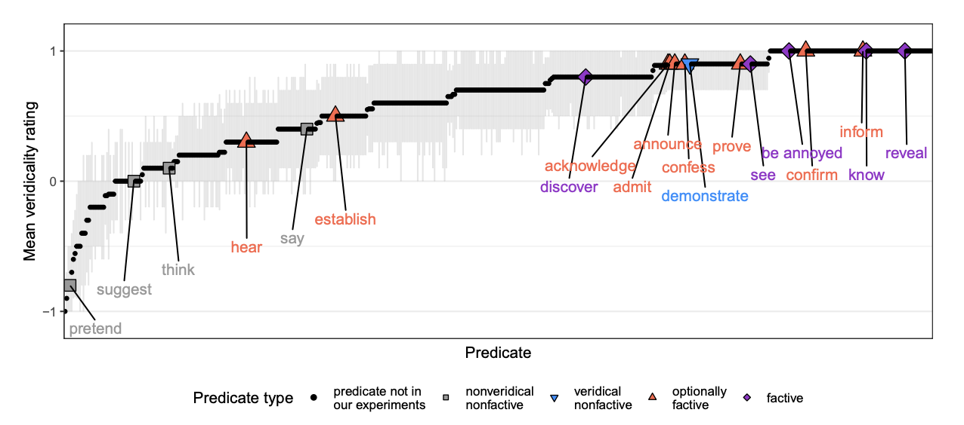
Factive
White & Rawlins 2018, White et al. 2018, Degen and Tonhauser 2022

Slide 32
Part 1
Part 2
From where does evidence for uncertainty come?
Is uncertainty about factive inferences resolved or unresolved?

Slide 33
Conventional + Conversational
Purely Conversational
Ambiguity
Resolved Uncertainty
Uncertainty across multiple distinct semantic values for an expression that have different preconditions of use.
Uncertainty across possible discrete states of a discourse that is resolved as a matter of integrating an utterance.
Uncertainty about the preconditions of use inherent to a single semantic value for an expression evoked on every use.
Vagueness
Uncertainty across possible discrete states of a discourse that is not resolved as a matter of integrating an utterance.
Unresolved Uncertainty

Slide 34
Part 1
Part 2
From where does evidence for uncertainty come?
Is uncertainty about factive inferences resolved or unresolved?
Part 3
Are factive inferences semantically encoded?

Slide 35
Conventional + Conversational
Purely Conversational
Ambiguity
Resolved Uncertainty
Uncertainty across multiple distinct semantic values for an expression that have different preconditions of use.
Uncertainty across possible discrete states of a discourse that is resolved as a matter of integrating an utterance.
Uncertainty about the preconditions of use inherent to a single semantic value for an expression evoked on every use.
Vagueness
Uncertainty across possible discrete states of a discourse that is not resolved as a matter of integrating an utterance.
Unresolved Uncertainty

Slide 36
Part 1
Part 2
From where does evidence for uncertainty come?
Is uncertainty about factive inferences resolved or unresolved?
Part 4
Part 3
Implications for semantic theory.
Are factive inferences semantically encoded?

Slide 37
Uncertainty about Factivity

Slide 38
Question
Where does evidence for uncertainty in factive inferences come from?
Answer
Aggregate measures derived from inference judgment tasks aimed at capturing projective inferences.

Slide 39
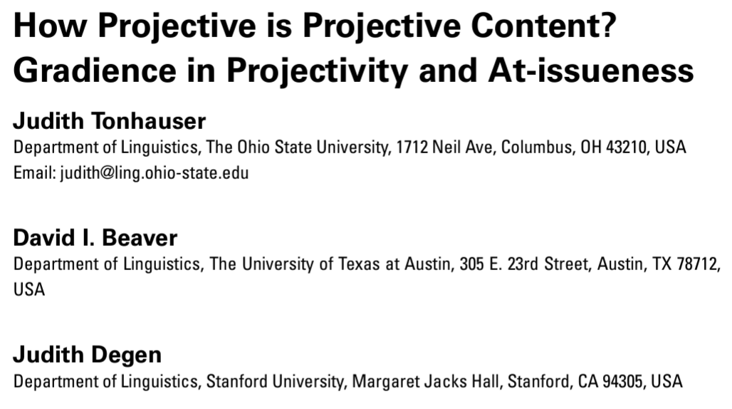
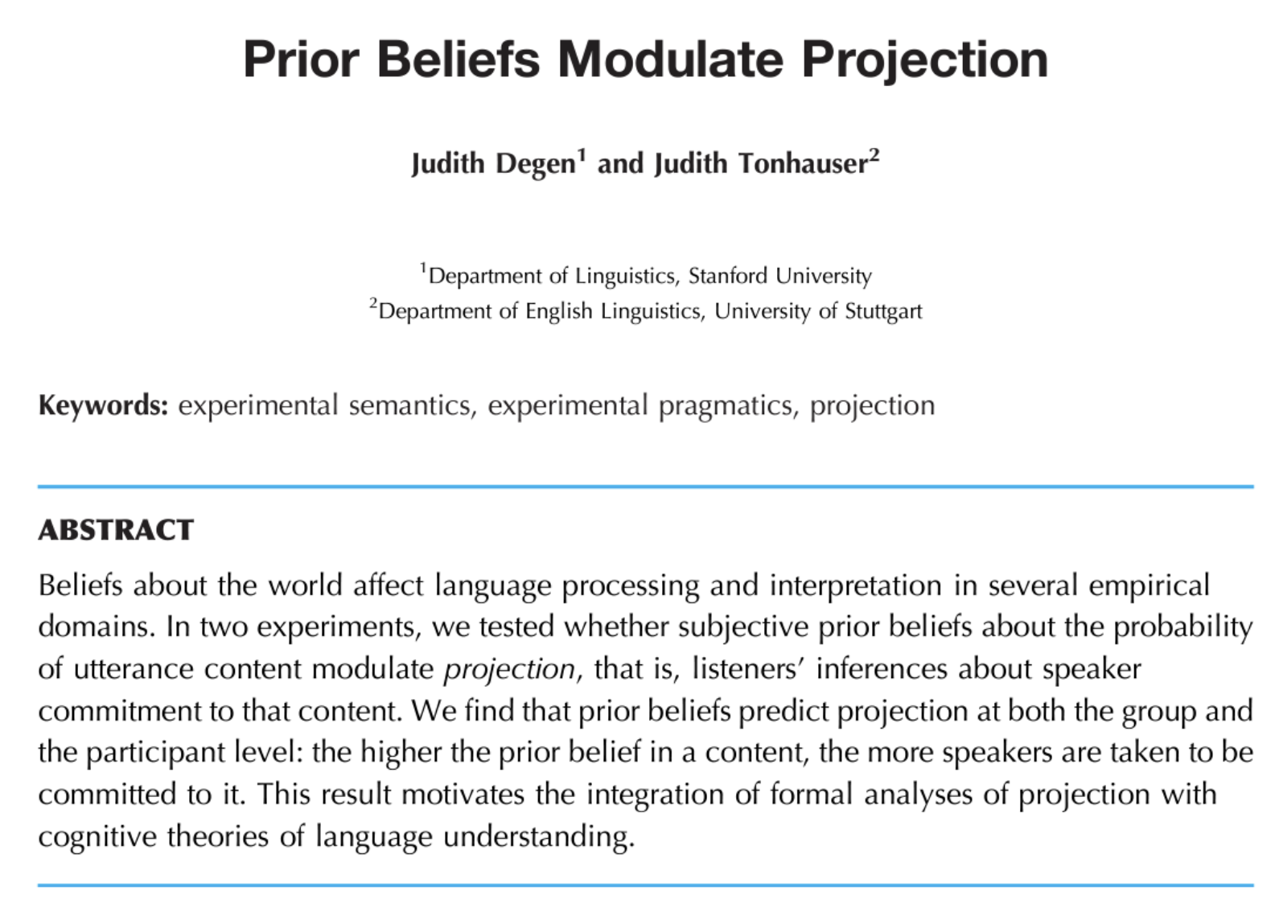
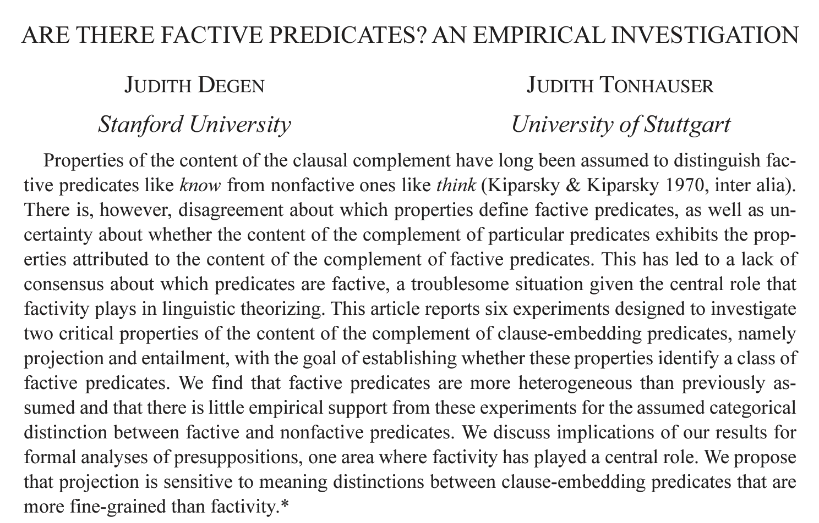

Slide 40
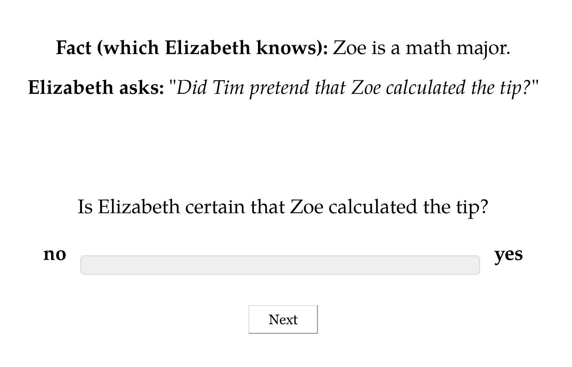

Slide 43
Norming Dataset
Measure prior knowledge: rate likelihood of proposition P given fact F.

Slide 44
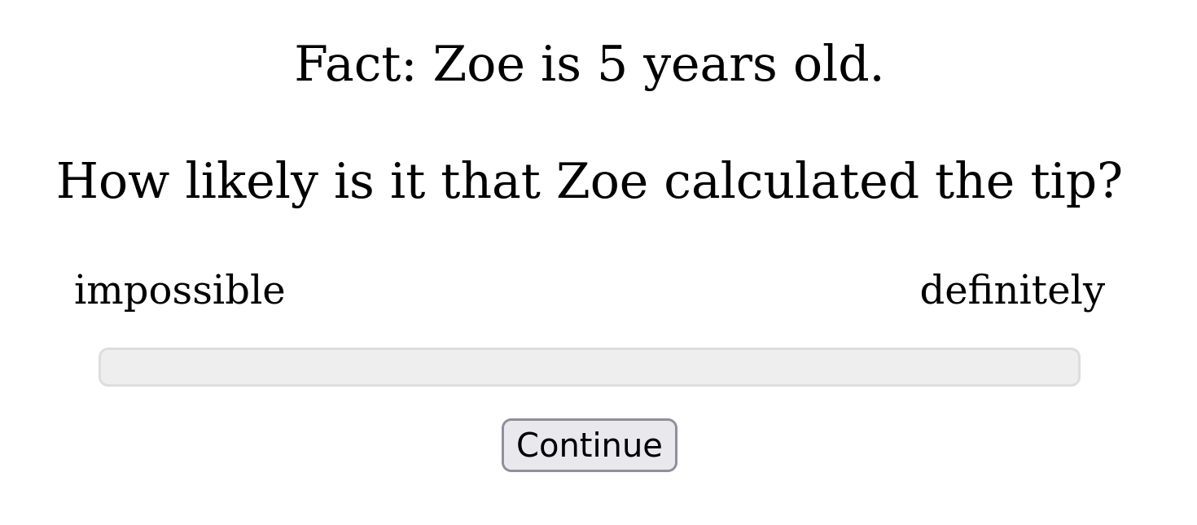

Slide 45
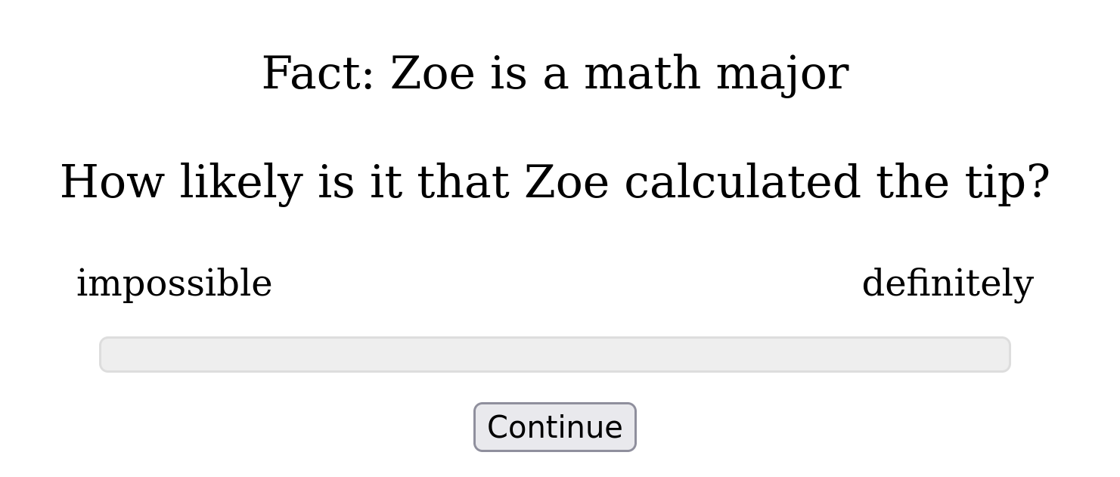

Slide 46
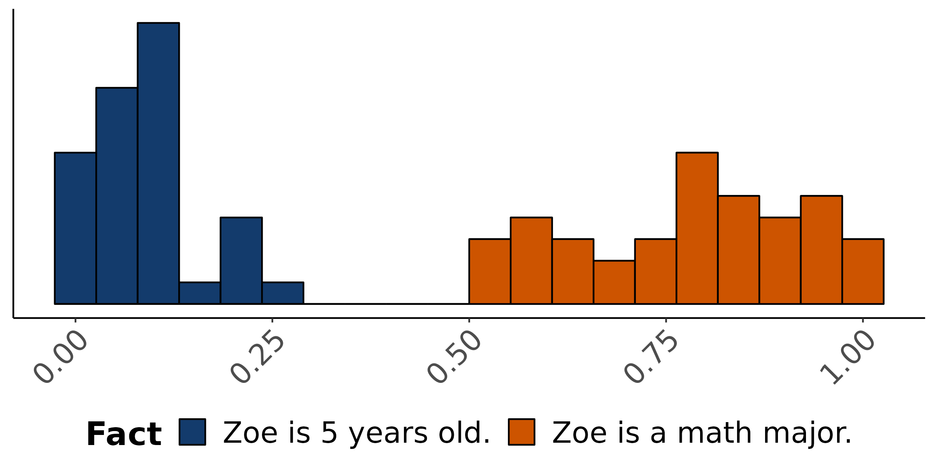
Empirical distribution of norming response
How likely is is that Zoe calculated the tip?

Slide 47
Norming Dataset
Measure prior knowledge: rate likelihood of proposition P given fact F.
Projection Dataset
Measure veridicality inferences: rate X’s certainty that P given F and a context where X asks Did/Does Y V that P?

Slide 48
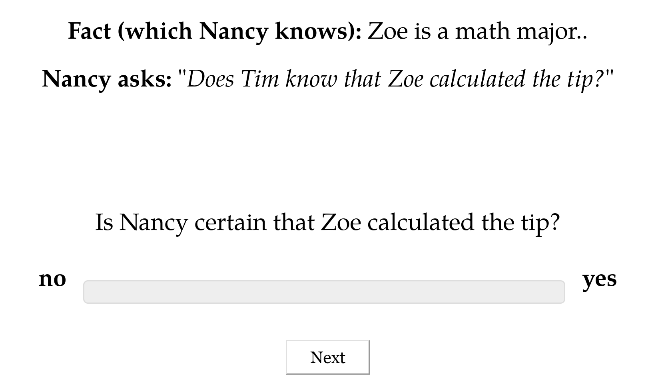

Slide 49
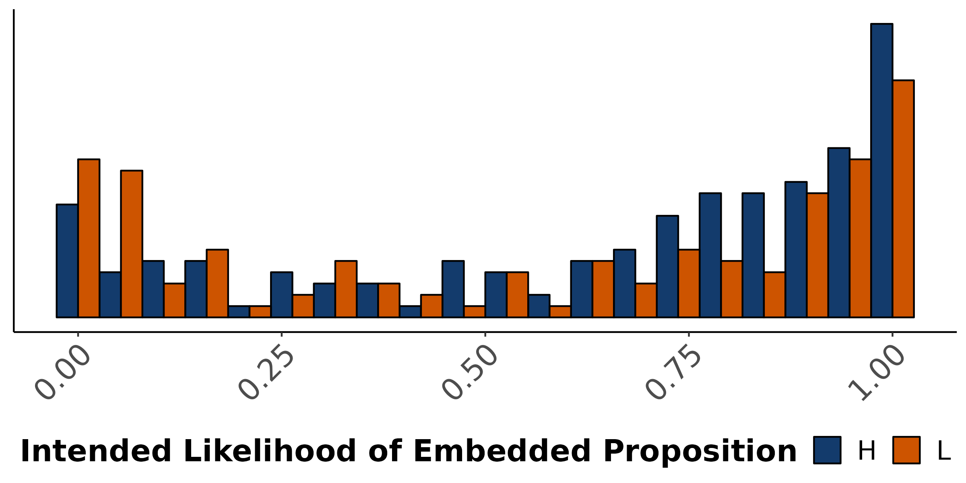
Empirical distribution of projection response
X asks: Does Y know that P?
Is X certain that P?

Slide 51
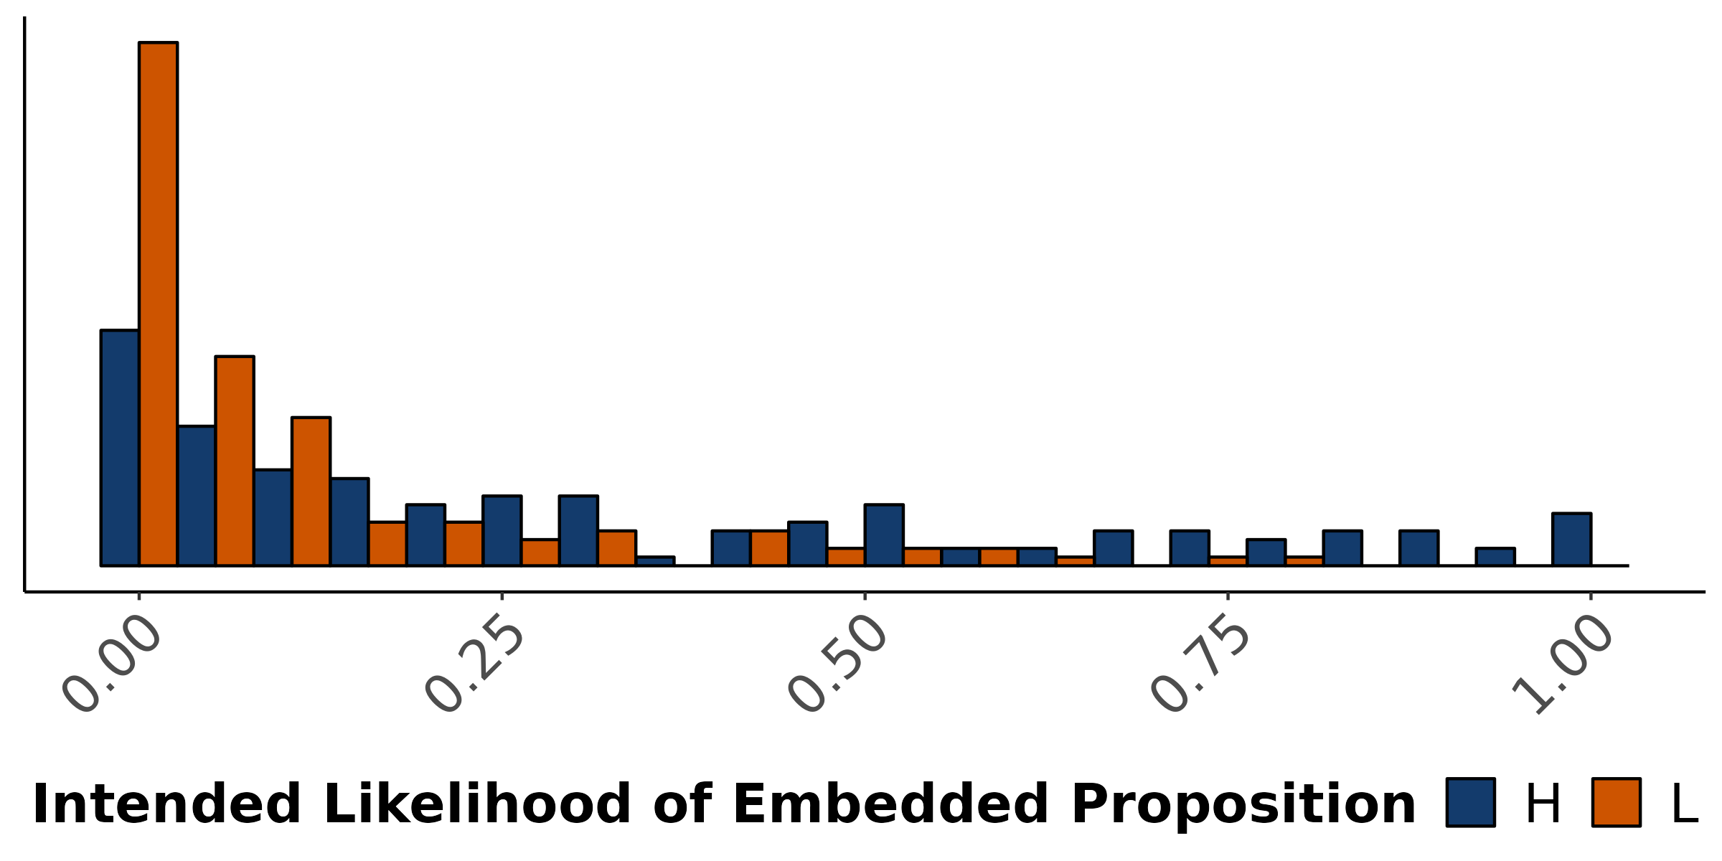
Empirical distribution of projection response
X asks: Did Y pretend that P?
Is X certain that P?

Slide 52
Resolving Uncertainty

Slide 53
Question
What do the two hypotheses about uncertainty (non)resolution predict about the distribution of judgments?

Slide 54
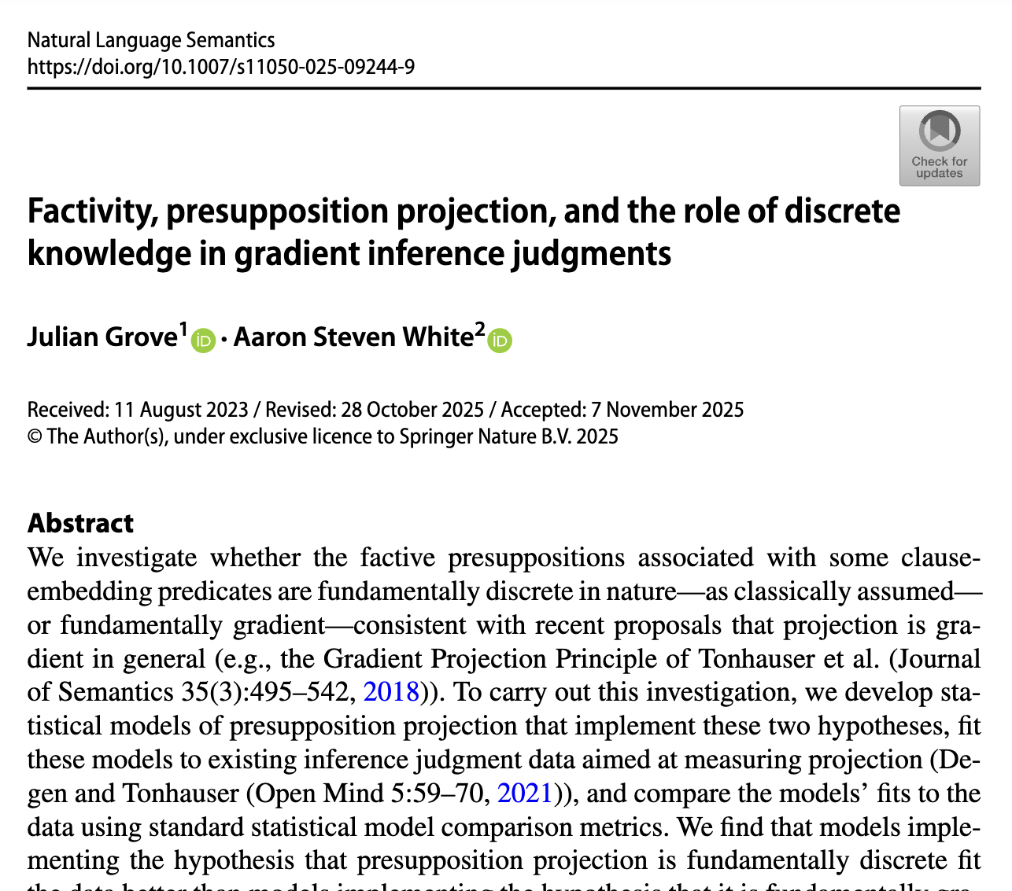
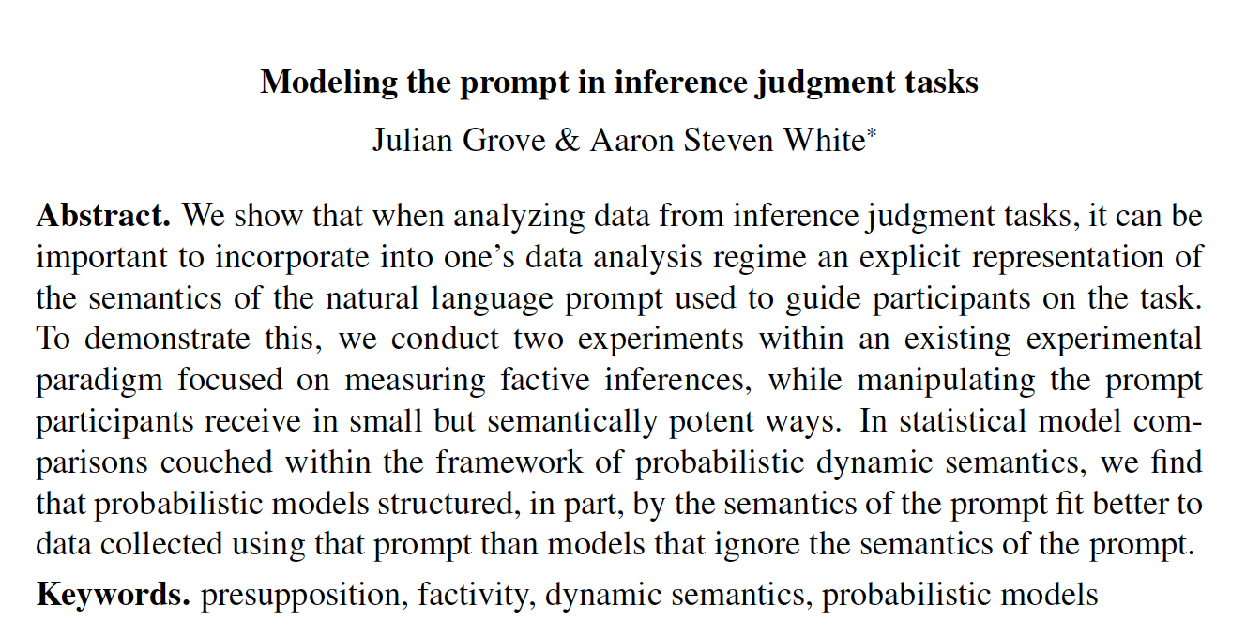
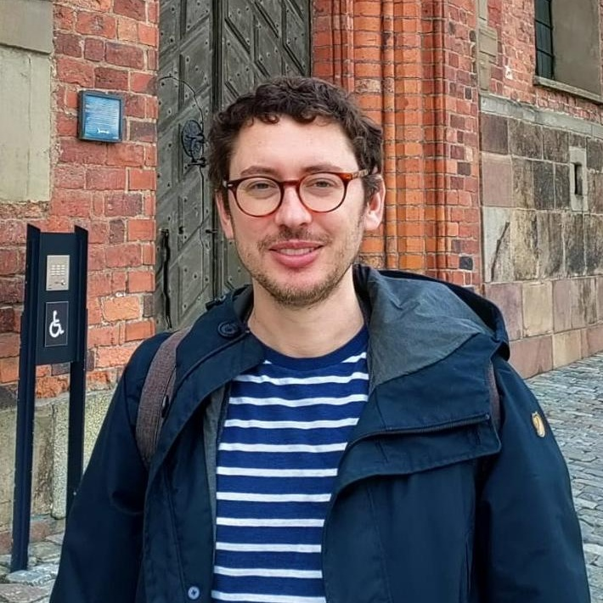
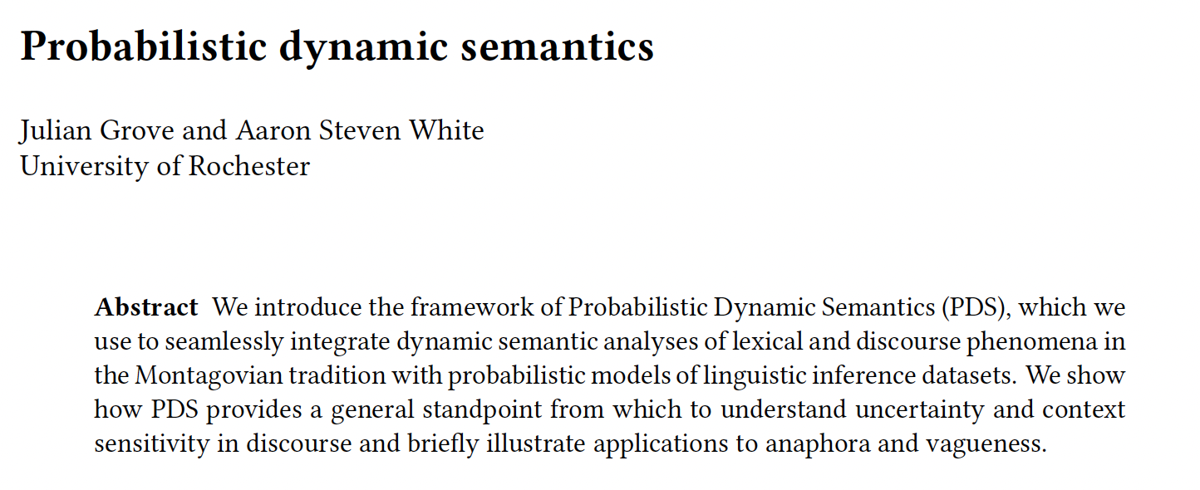
In Proceedings of Experiments in Linguistic Meaning 3
Under review at Cambridge Elements in Semantics
Julian Grove
University of Florida

Slide 55
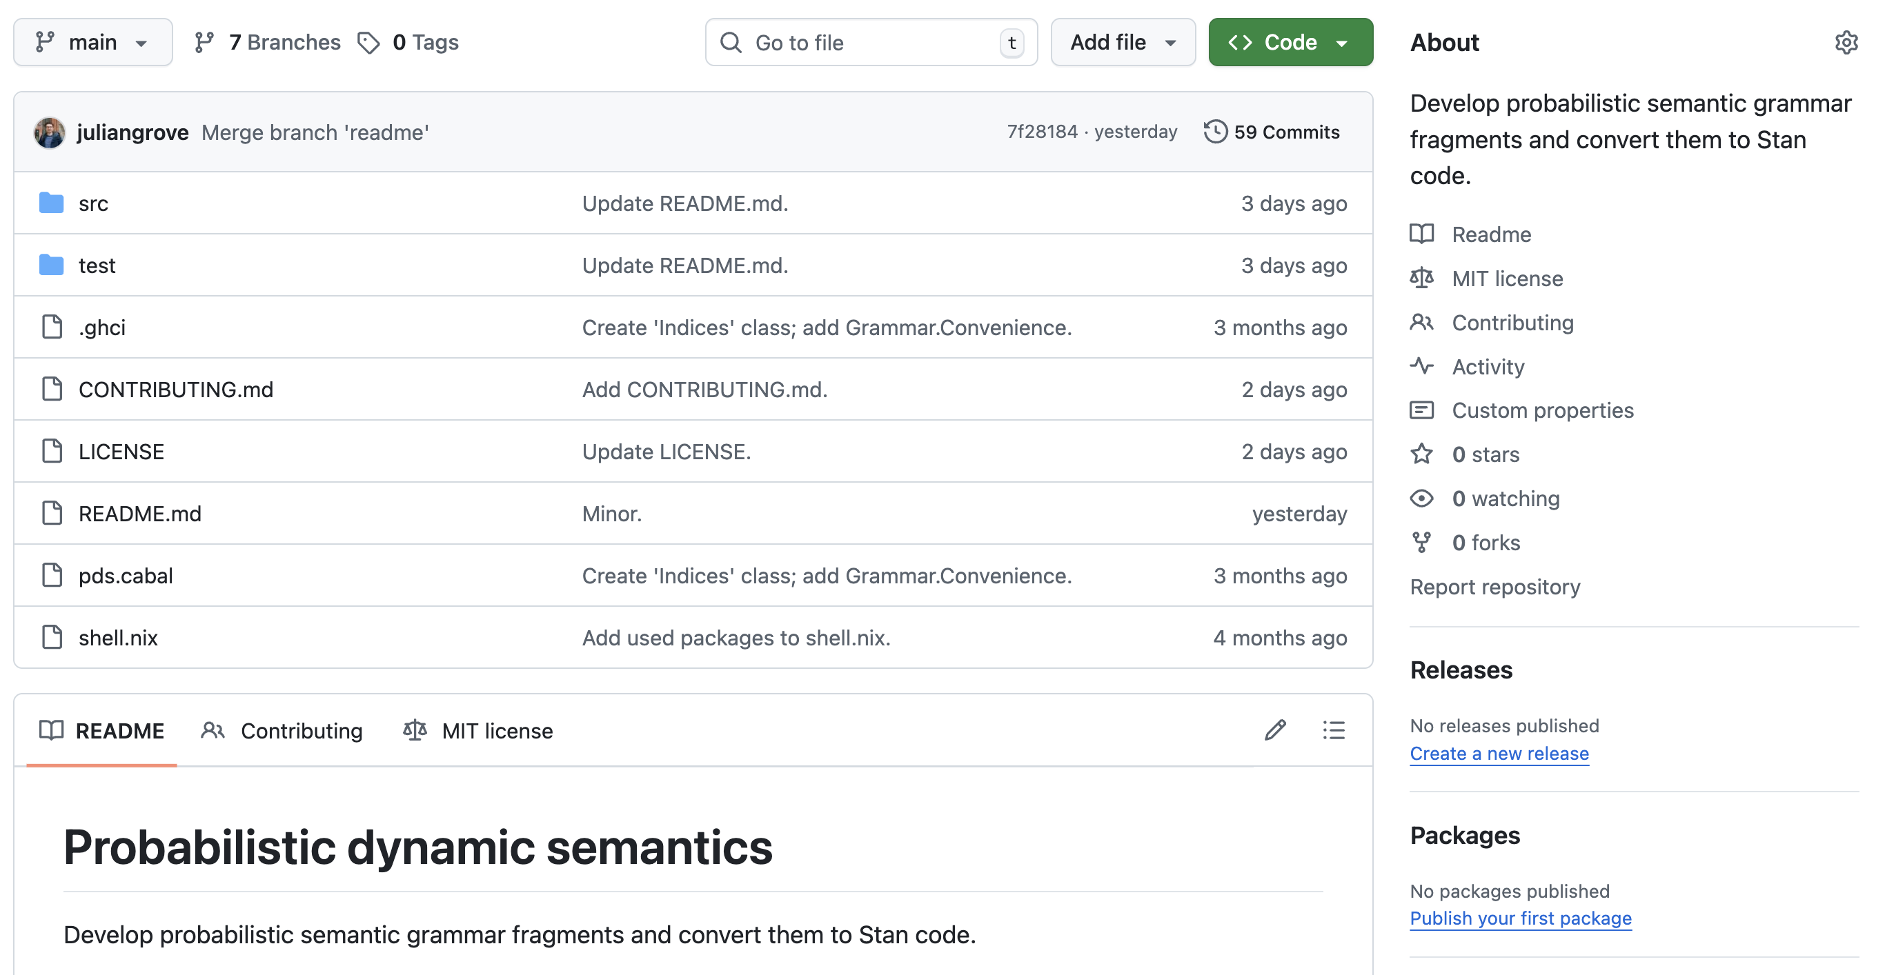
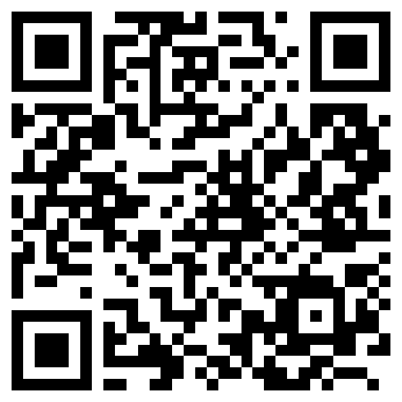
github.com/probabilistic-dynamic-semantics/pds

Slide 56
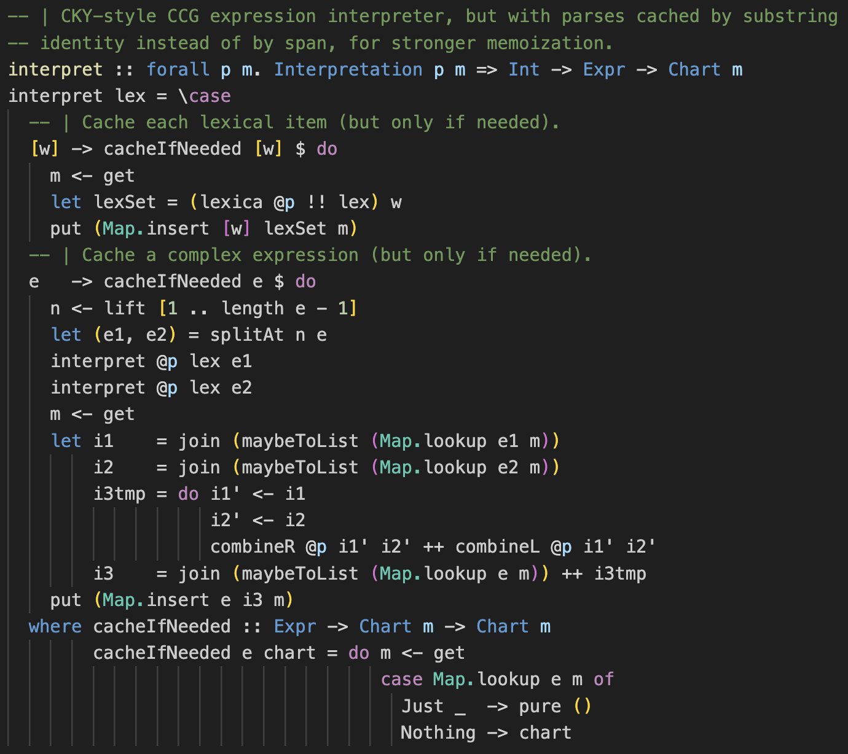
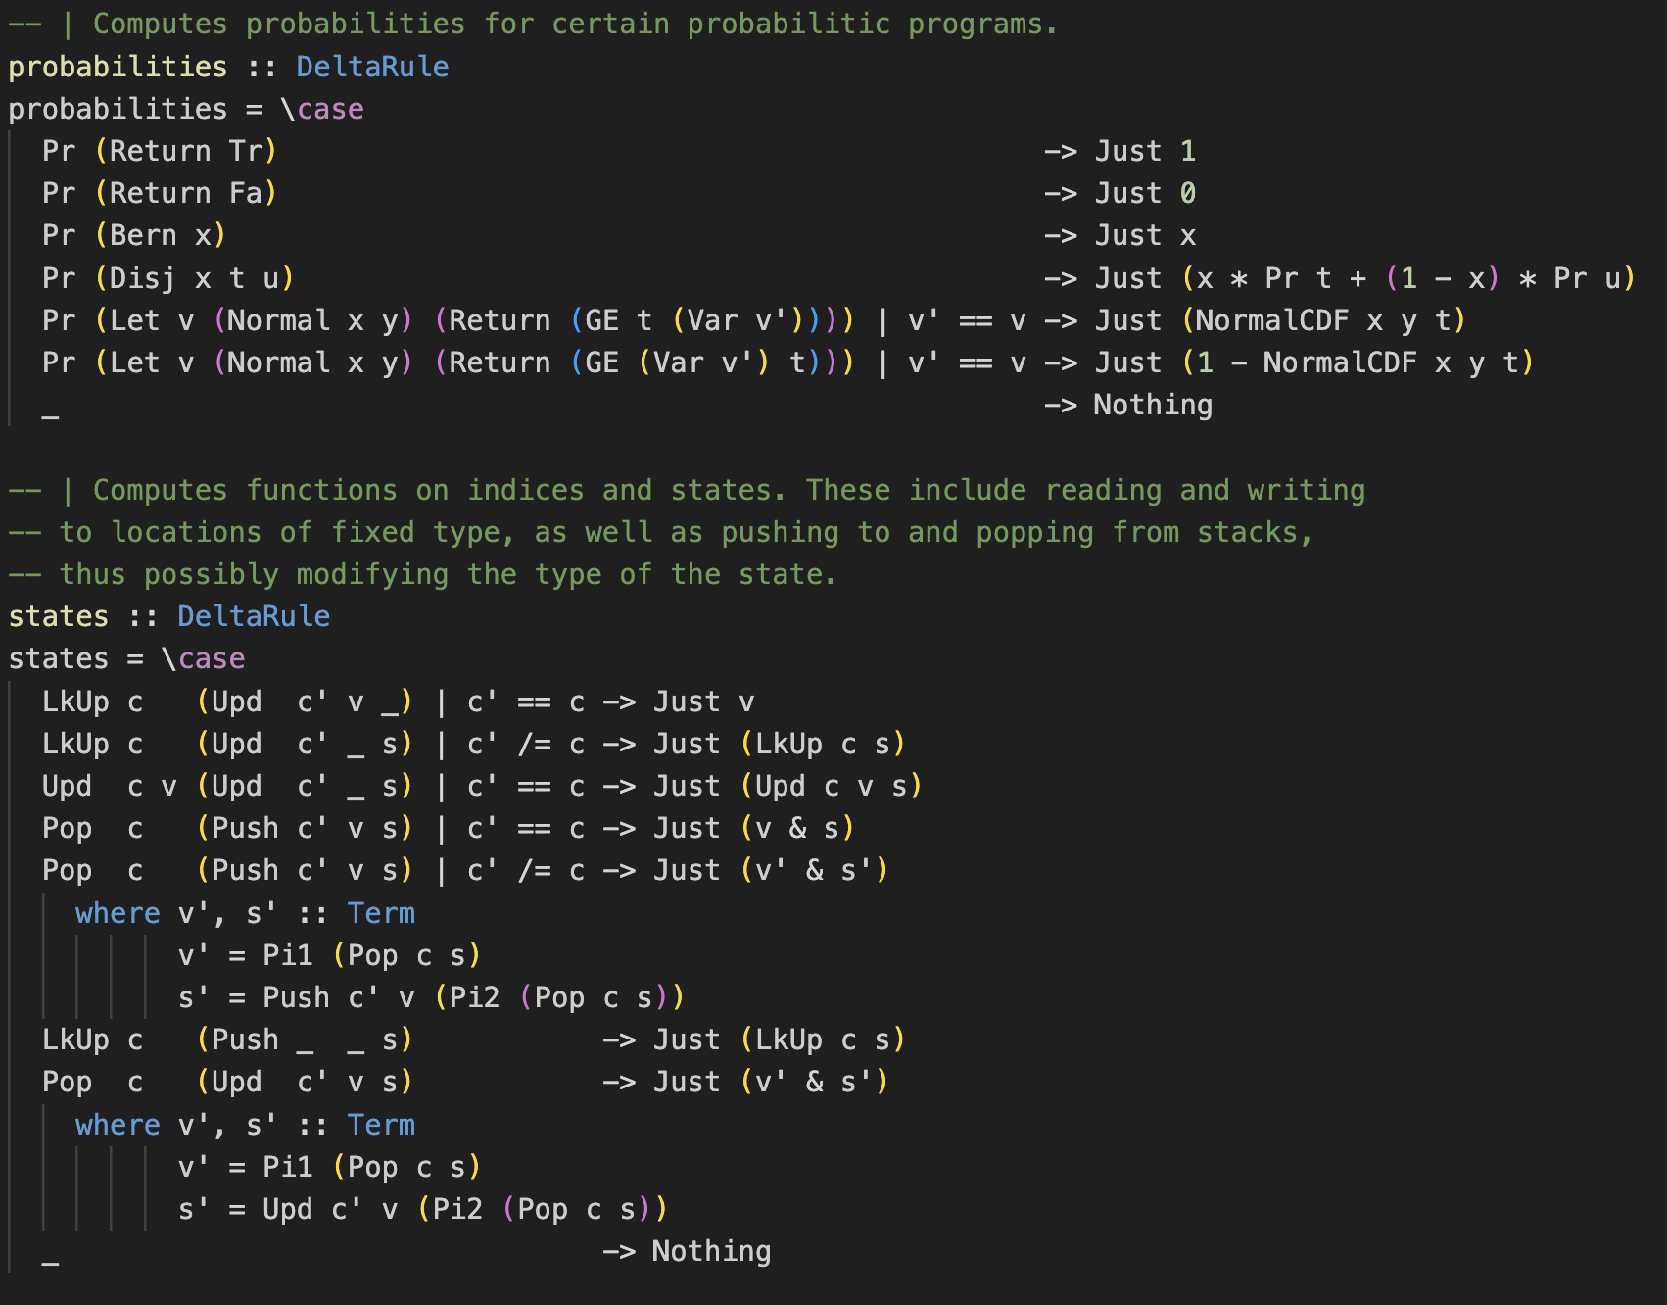
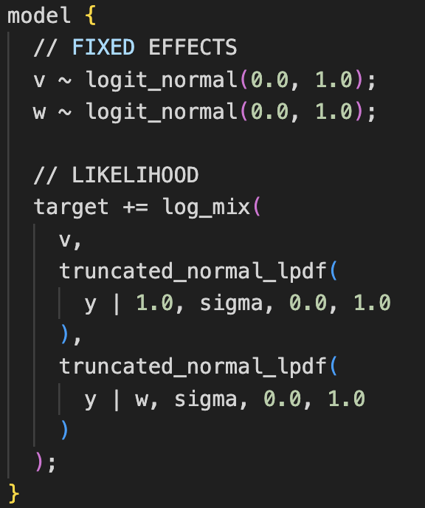
Compositionally derive statistical models of judgment data!
PARSE
COMPILE

Slide 57
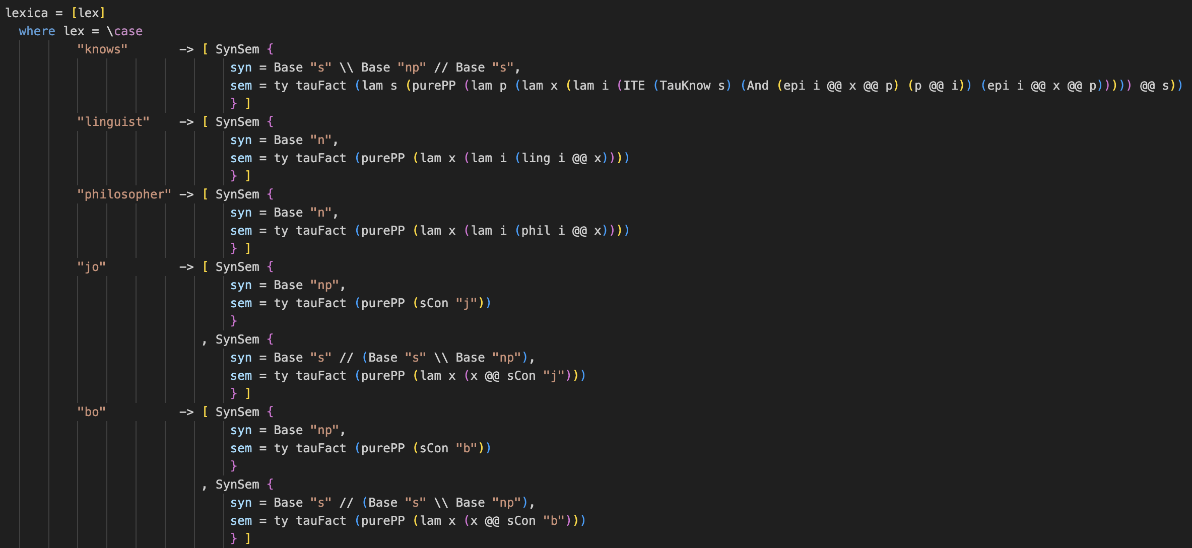
Define semantic values in the normal way!
Distinct hypotheses = distinct lexica

Slide 58
Nonresolution hypothesis
Judgments follow a single distribution whose expected value is determined by the predicate + embedded content.

Slide 59
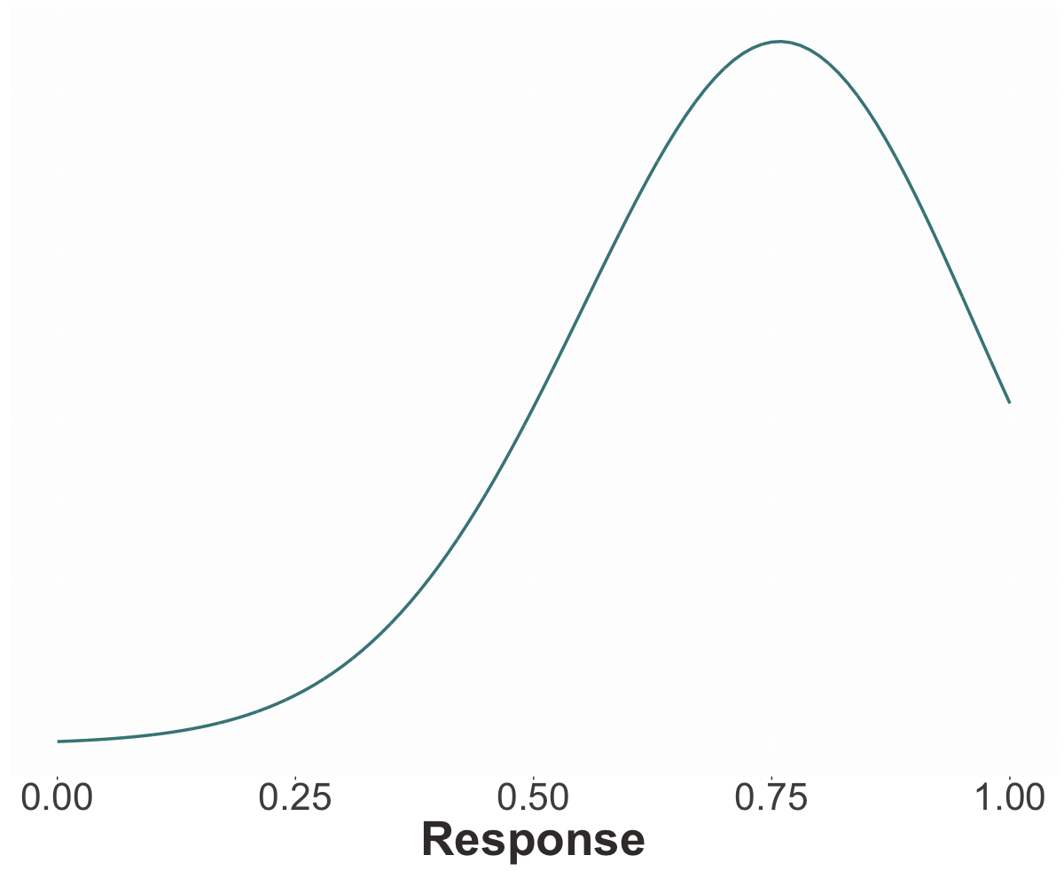
predicate triggers projection or
embedded content is true
Prob
Noise due to non-linguistic factors

Slide 60
Nonresolution hypothesis
Judgments follow a single distribution whose expected value is determined by the predicate + embedded content.
Resolution hypothesis
Judgments follow a mixture of three distributions: the FALSE and TRUE distributions, determined by the predicate, and the PRIOR distribution, determined by EC.

Slide 61
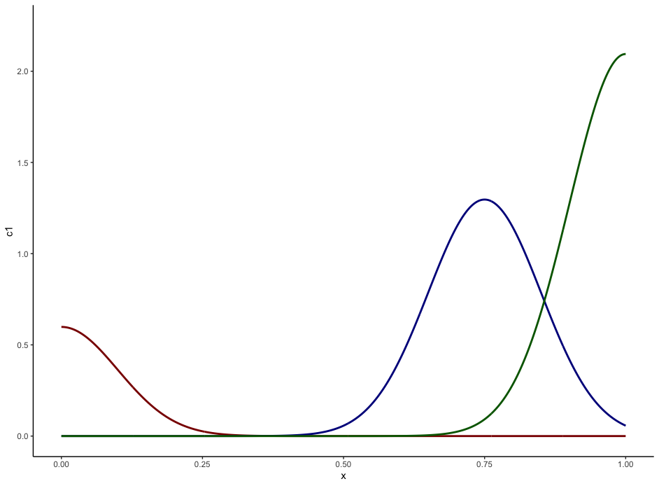
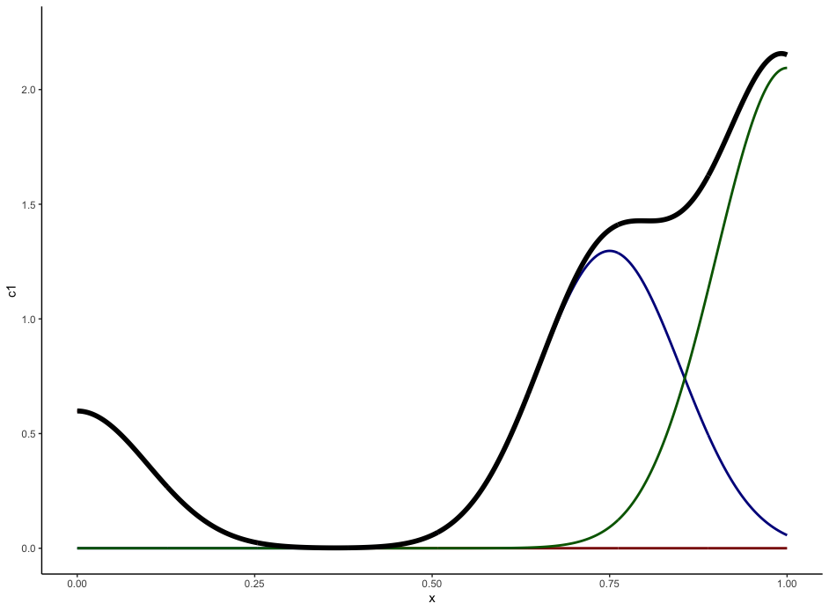
TRUE
predicate triggers projection
Prob
embedded content is true
Prob
PRIOR
predicate triggers projection NOT
Prob
FALSE
Noise due to non-linguistic factors

Slide 62
Method
Fit models to D&T’s norming and compare fits.
Fit models to D&T’s projection data, with priors determined by norming fits, and compare fits.

Slide 63
TRUE
predicate triggers projection
Prob
embedded content is true
Prob
PRIOR
predicate triggers projection NOT
Prob
FALSE

Slide 64
TRUE
embedded content is true
Prob
PRIOR
FALSE

Slide 65
Question #1
Is uncertainty about prior beliefs resolved or unresolved?

Slide 66
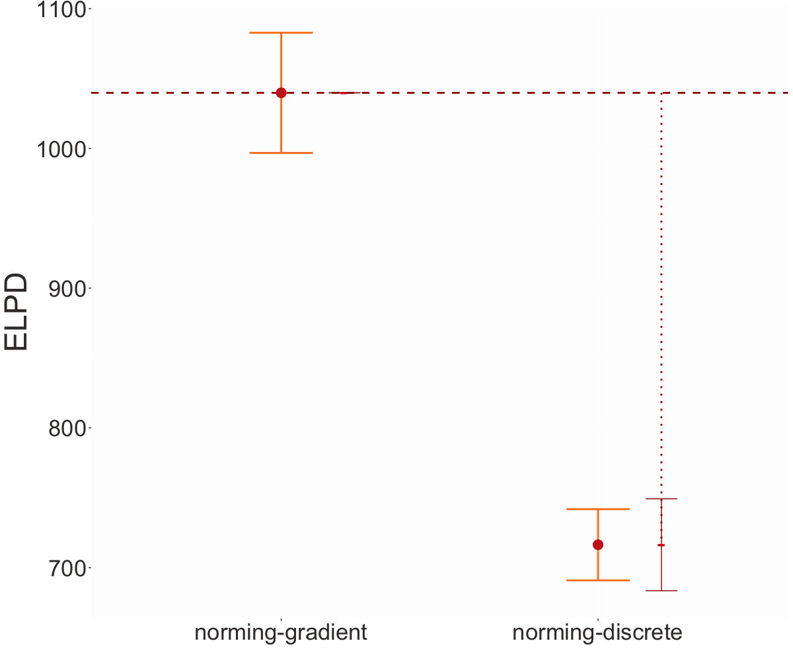
Higher means better fit
Uncertainty about prior beliefs is unresolved.
Unresolved
Resolved

Slide 67
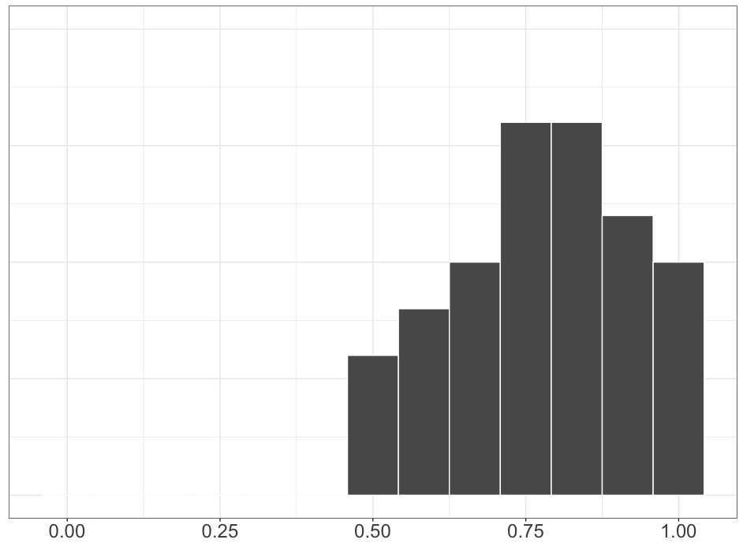
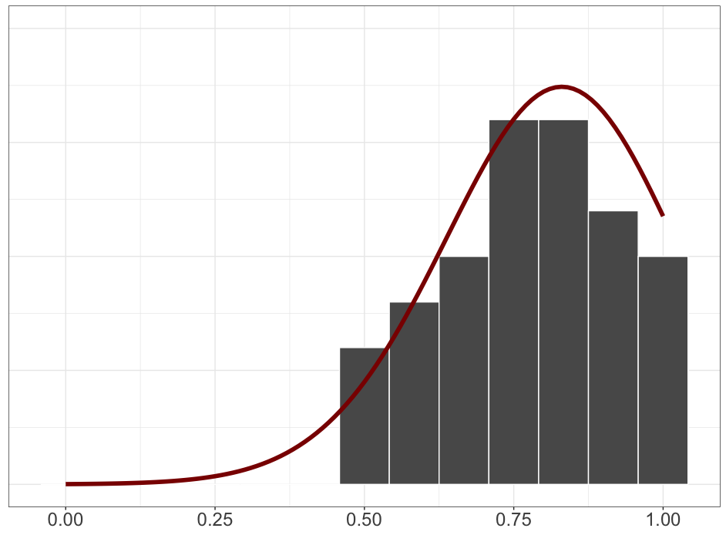
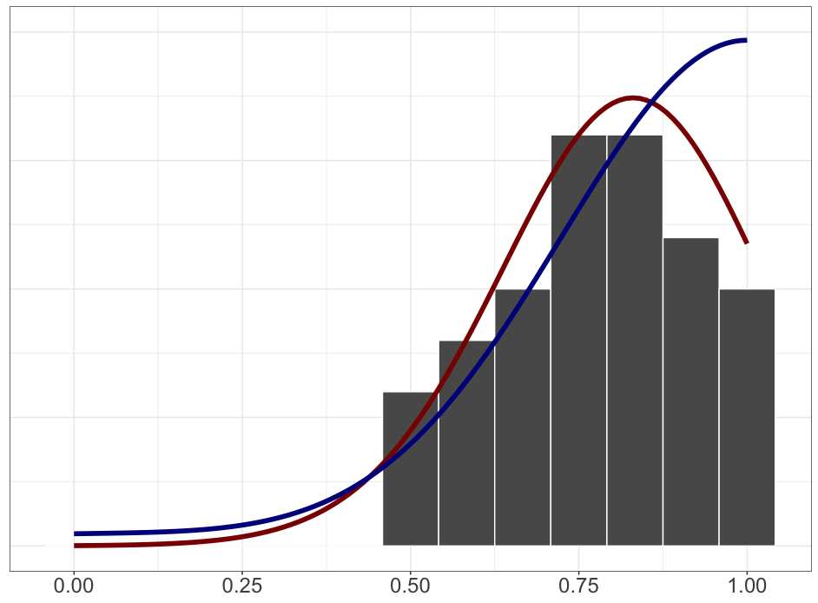
Resolved
Unresolved

Slide 68
Question #1
Is uncertainty about prior beliefs resolved or unresolved?
Question #2
Is uncertainty about factive inferences resolved or unresolved?

Slide 69
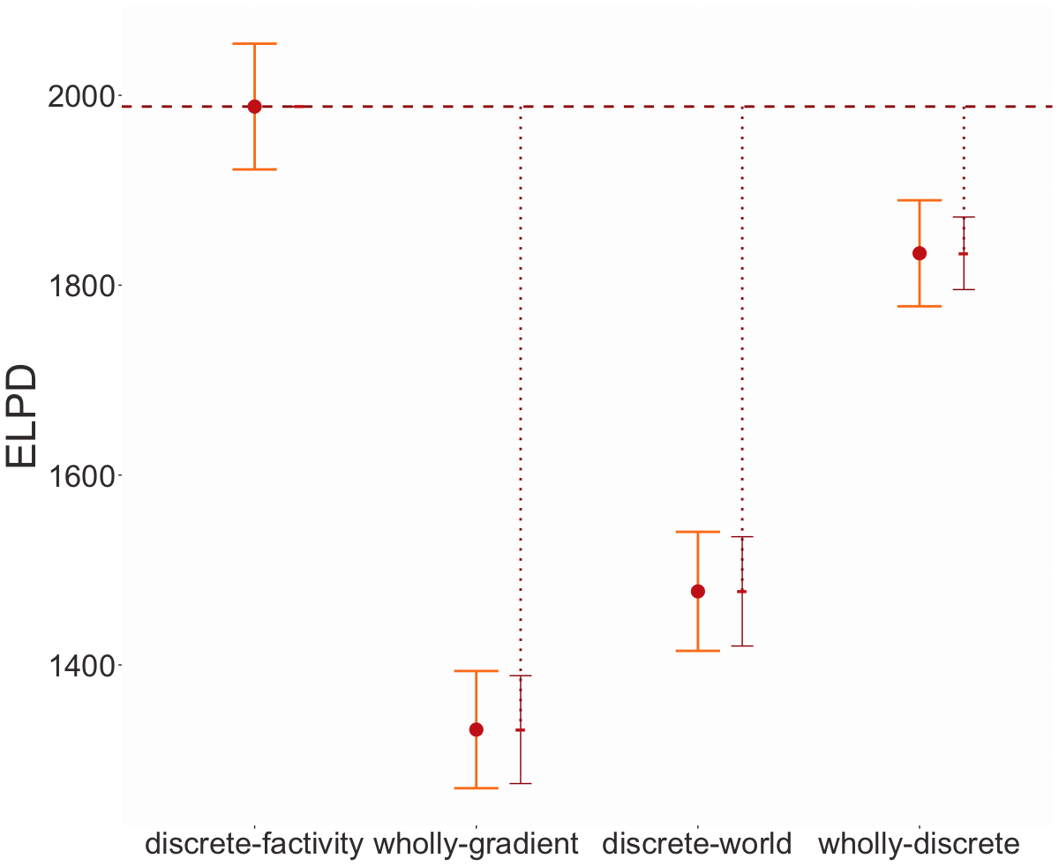
Uncertainty about factive inferences is resolved.
Factivity
Resolved
Factivity
Unresolved
Factivity
Unresolved
Factivity
Resolved

Slide 70
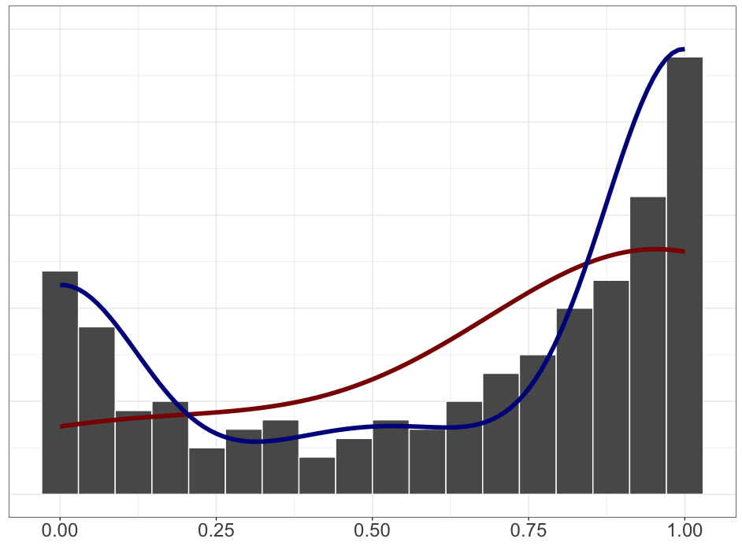
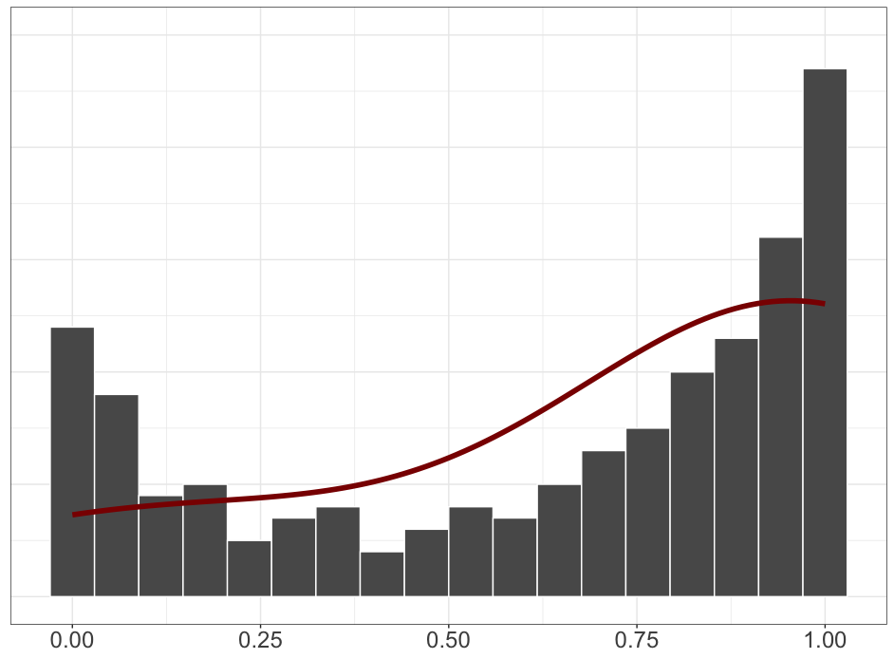
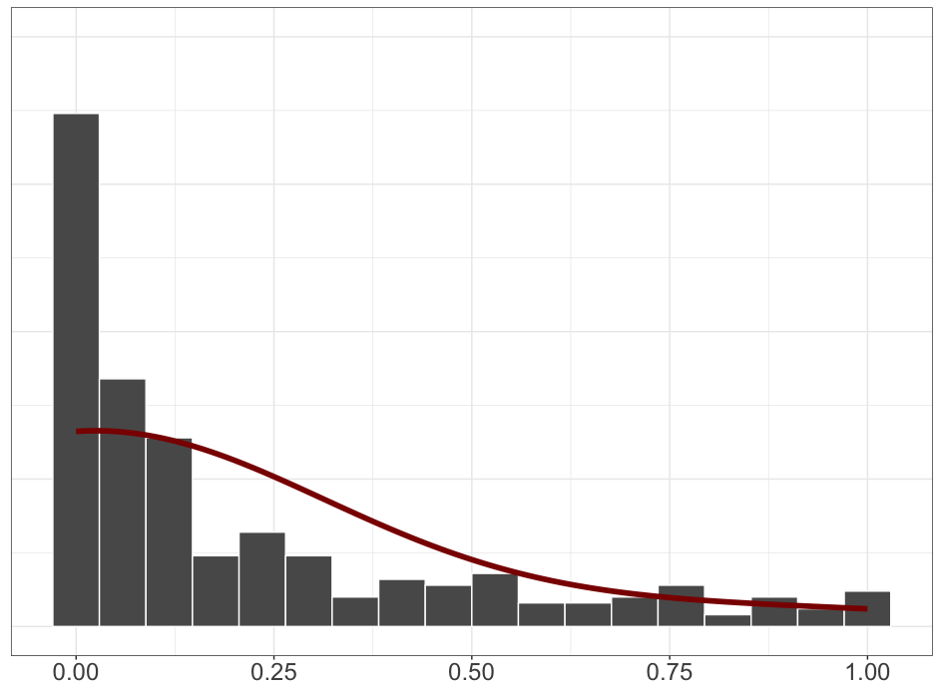
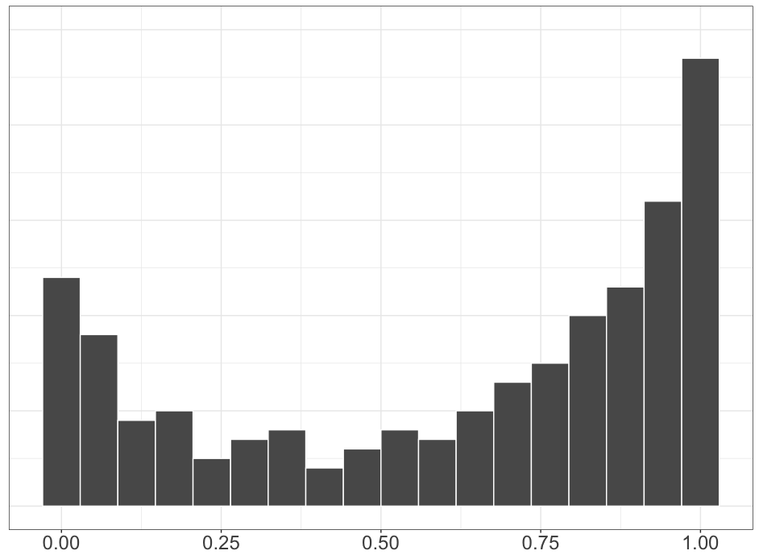
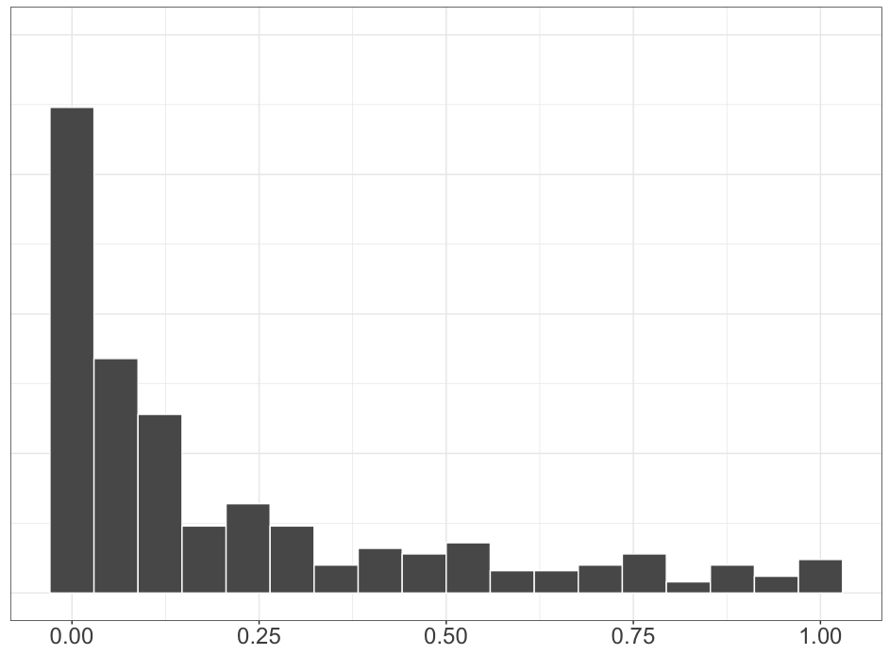
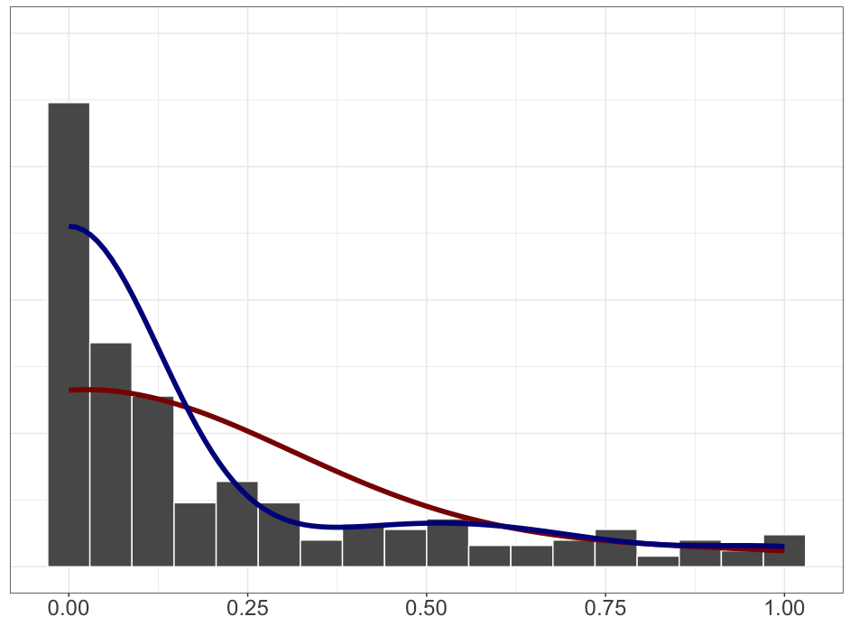
know
pretend
Resolved
Resolved
Unresolved
Unresolved

Slide 71
Question #3 see Appendix B
Does the prompt encourage participants to “respond more discretely” because the prompt is a polar question?

Slide 73
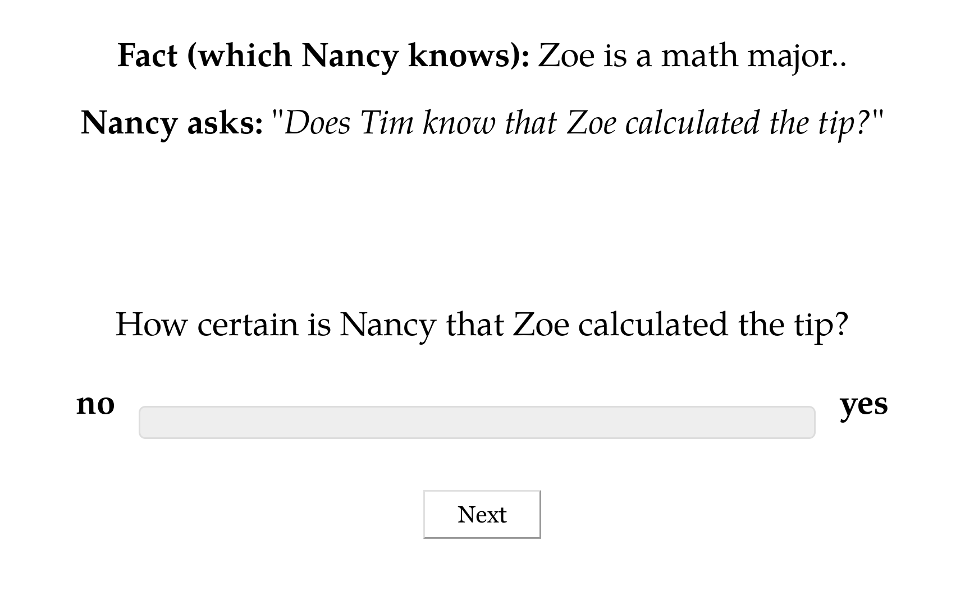

Slide 74
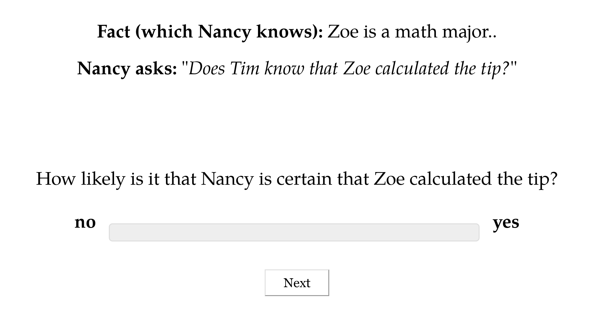

Slide 75
In Proceedings of Experiments in Linguistic Meaning 3
Under review at Cambridge Elements in Semantics
Julian Grove
University of Florida

Slide 76
PARSE
COMPILE

Slide 77
Question #3 see Appendix B
Does the prompt encourage participants to “respond more discretely” because the prompt is a polar question?
Question #4 see Appendix C
Do contents biased for high or low likelihood cause people to “respond more discretely”?

Slide 78
In Proceedings of Experiments in Linguistic Meaning 3
Under review at Cambridge Elements in Semantics
Julian Grove
University of Florida

Slide 79
Interim Discussion

Slide 80
Question
Is uncertainty about factive inferences resolved or unresolved?
Answer
Uncertainty in factive inferences is resolved, even though uncertainty about prior beliefs is unresolved.

Slide 81
Conventional + Conversational
Purely Conversational
Ambiguity
Resolved Uncertainty
Uncertainty across multiple distinct semantic values for an expression that have different preconditions of use.
Uncertainty across possible discrete states of a discourse that is resolved as a matter of integrating an utterance.
Uncertainty about the preconditions of use inherent to a single semantic value for an expression evoked on every use.
Vagueness
Uncertainty across possible discrete states of a discourse that is not resolved as a matter of integrating an utterance.
Unresolved Uncertainty

Slide 82
Next Question
Are factive inferences driven by some semantically encoded property (or properties)?
Prediction
If there were such a property or properties, they should…
…show a trace in the inference judgment profiles and…
…that trace should be correlated with distribution.

Slide 83
Predicates don’t appear to cluster!
White & Rawlins 2018, White et al. 2018, Degen and Tonhauser 2022

Slide 84
Possibility #1
Lack of apparent clustering may be due to noise in the measurement.

Slide 85
yes
Factives
Someone didn’t __ that a particular thing happened?
Did that thing happen?
Antiveridicals
Nonfactives
Veridicals
no
yes
Someone __ed that a particular thing happened?
Did that thing happen?
White & Rawlins 2018

Slide 86
yes
Someone didn’t __ that a particular thing happened?
Did that thing happen?
no
yes
Someone __ed that a particular thing happened?
Did that thing happen?
White & Rawlins 2018

Slide 87
Possibility #1
Lack of apparent clustering may be due to noise in the measurement.
Possibility #2
Lack of apparent clustering may be due to predicates that are polysemous with respect to factive and nonfactive subclasses of clause-embedding predicates.

Slide 88
It worries Leo that Thea left.
Thea left.
Leo worries that Thea left.

Slide 89
Question
If we develop a model that accounts for measurement noise and the possibility of polysemy, are factive inferences correlated with distribution?

Slide 90
Semantic Encoding

Slide 91
Approach
Induce full classification of clause-embedding lexicon from (i) inference types that clause-embedding predicates are known to vary on; and (ii) a measure of distribution.

Slide 92
Cognitive Nonfactives
Cognitive Semifactives
Positive Emotive Factives
thinks
suspects
knows
realized
likes
is happy
A believes that B happened.
A believes that B happened.
A believes that B happened.
B happened.
A believes that B happened.
A wants B to have happened.
think
suspect
know
realize
doesn’t like
isn’t happy
A doesn’t believes that B happened.
A doesn’t believes that B happened.
A doesn’t believes that B happened.

Slide 93
Approach
Induce full classification of clause-embedding lexicon from (i) inference types that clause-embedding predicates are known to vary on; and (ii) a measure of distribution.
Ensures induced classes are cohesive with respect to both inference and distribution and thus plausibly semantic!

Slide 94
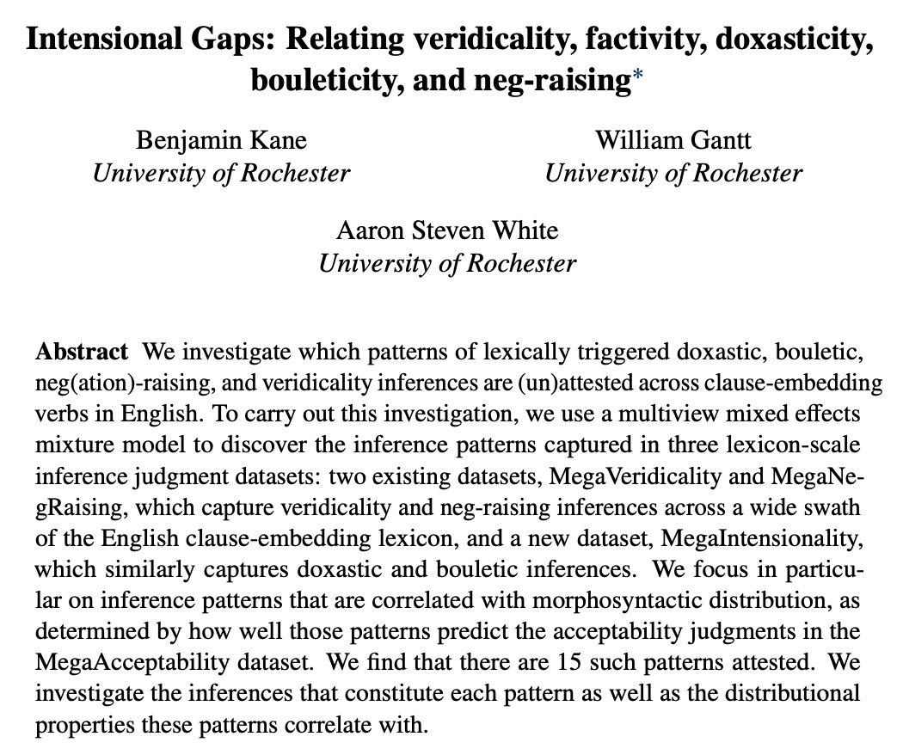
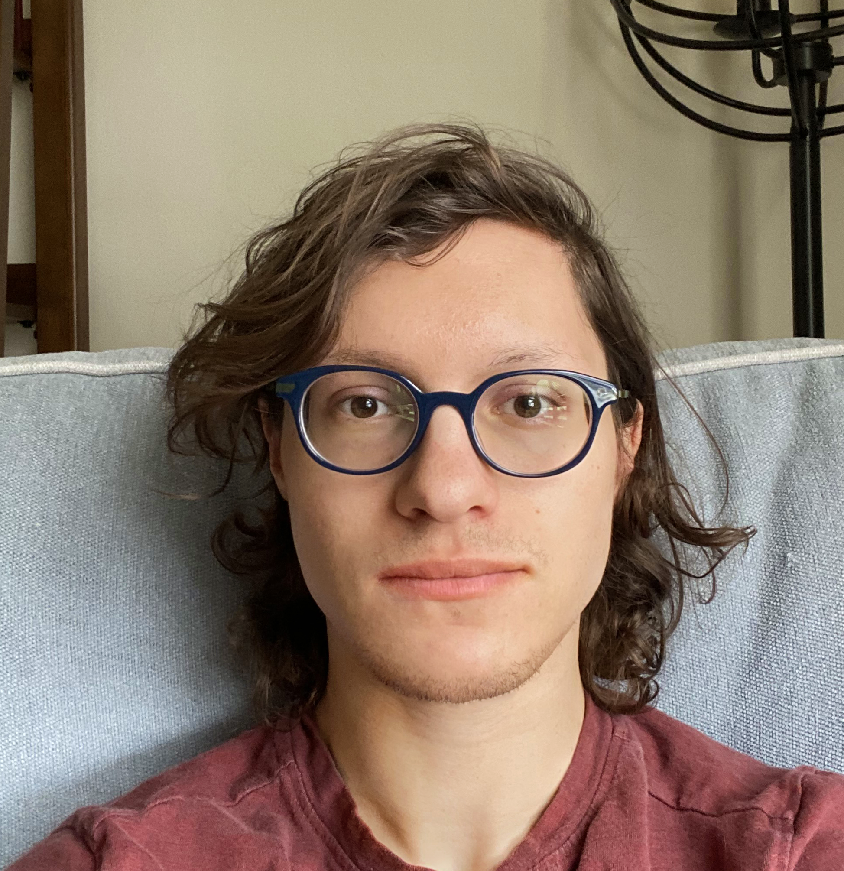
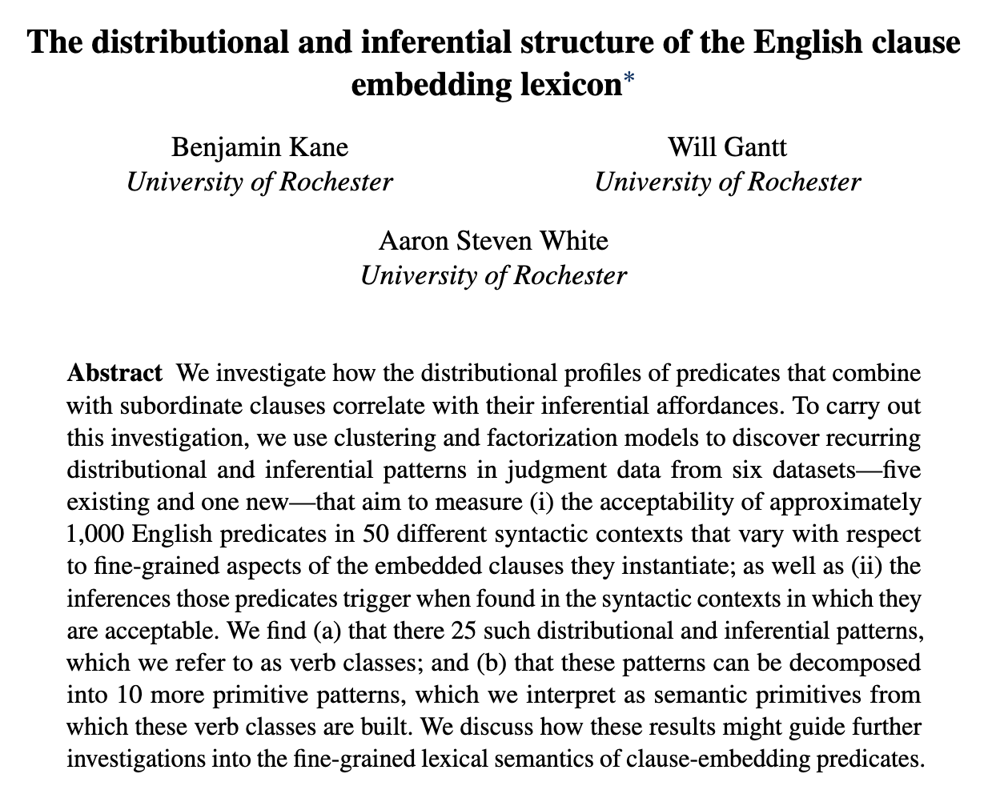
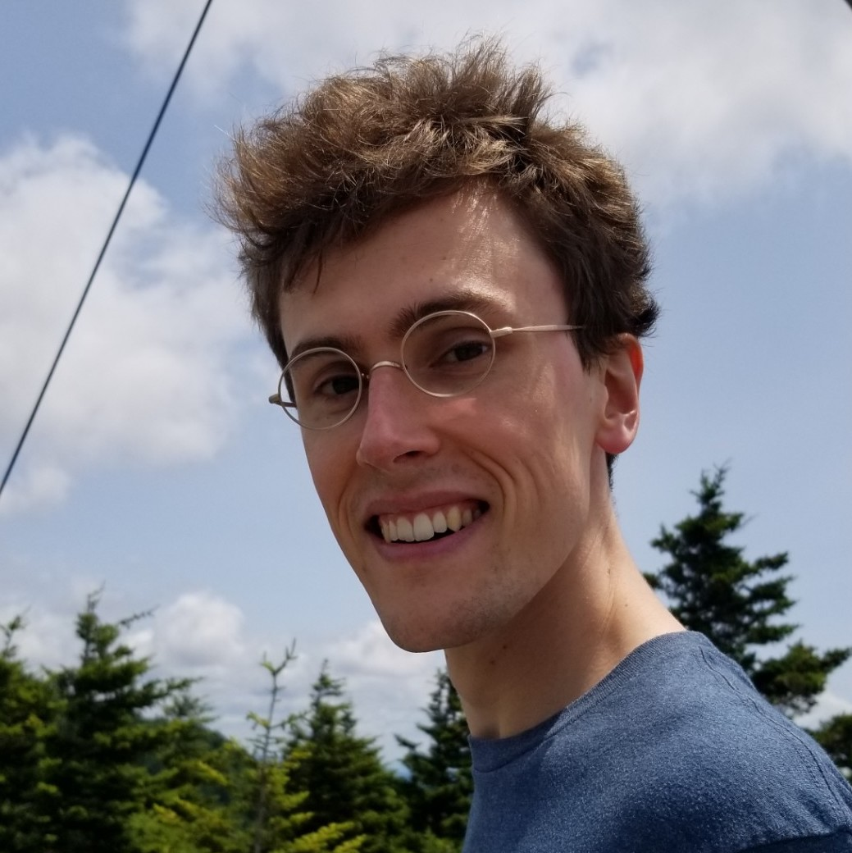
In preparation!
Ben Kane
OpenStream.AI
Will Gantt
Johns Hopkins University

Slide 95
Question
Are any of the induced classes associated with factive inferences (whether they are consistent the prior lit or not)?

Slide 96
Data Component #1
Measure of distribution using acceptability judgments.
Data Component #2
Measure of inferences beyond factive inferences.

Slide 97
Semantic Encoding
Measuring Distribution

Slide 98
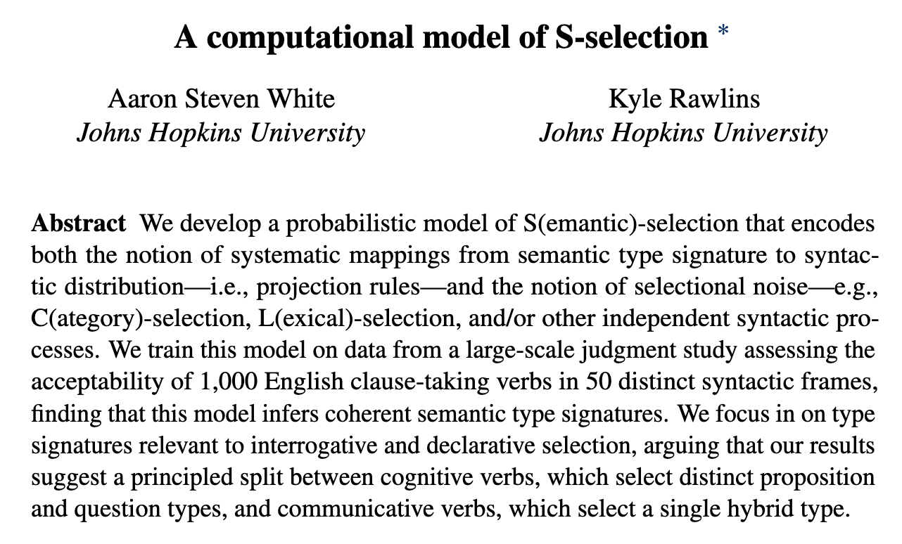
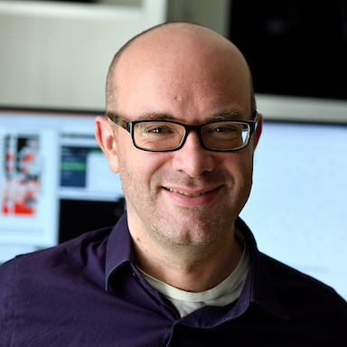
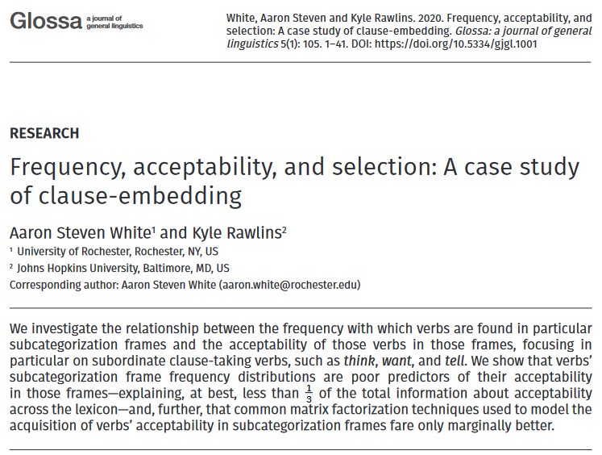
Kyle Rawlins
Johns Hopkins University

Slide 99
MegaAcceptability Dataset
Acceptability for 1,000 verbs in 50 syntactic frames focused on clause-embedding.

Slide 100
Verbs
think
know
wonder
love
surprise
tell
say
start
stop
...

Slide 101
Bleaching Method
Frame templates (e.g. NP __ that S) instantiated by semantically bleached fillers.

Slide 102
Verbs
Frames
think
Someone __ed something happened
know
Someone __ed that something happened
wonder
Someone __ed whether something happened
love
Someone __ed which thing happened
x
surprise
Someone __ed someone that something happened
tell
Someone __ed someone whether something happened
say
Someone __ed to someone that something happened
start
Someone __ed to do something
stop
Someone __ed someone to do something
...
...

Slide 103
MegaAcceptability Dataset
Acceptability for 1,000 verbs in 50 syntactic frames focused on clause-embedding.
50,000 total items x 5 judgments per item

Slide 104
Question
Is bleaching a valid method for capturing the acceptability of a verb in a frame?

Slide 105
Validation Strategy #1 see Appendix D
Compare judgments for bleached items against judgments from trained linguists.
Validation Strategy #2 see Appendix E
Assess generalization drawn from linguist hand-coding of acceptability across many predicates.

Slide 106
Semantic Encoding
Measuring Inference

Slide 107
Recipe
Validate a bleaching paradigm for collecting judgments for an inference type.
Select a set of frames of interest.
Select predicates acceptable in those frames using MegaAcceptability.
Collect judgments using the paradigm.

Slide 108
Veridicality task

Slide 109
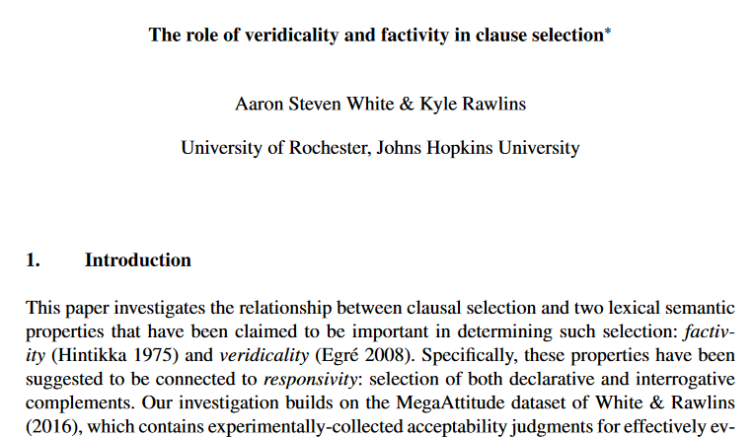
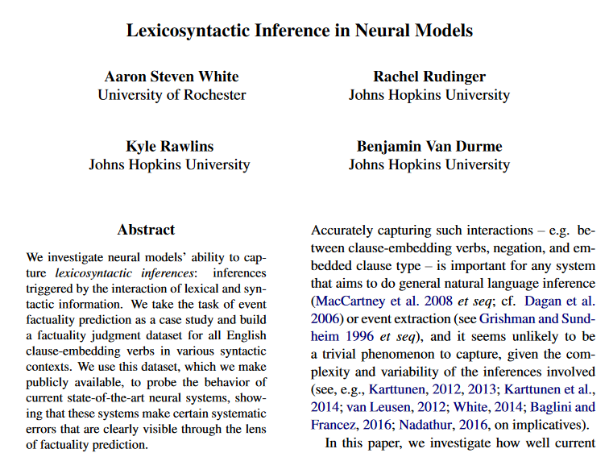
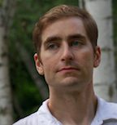
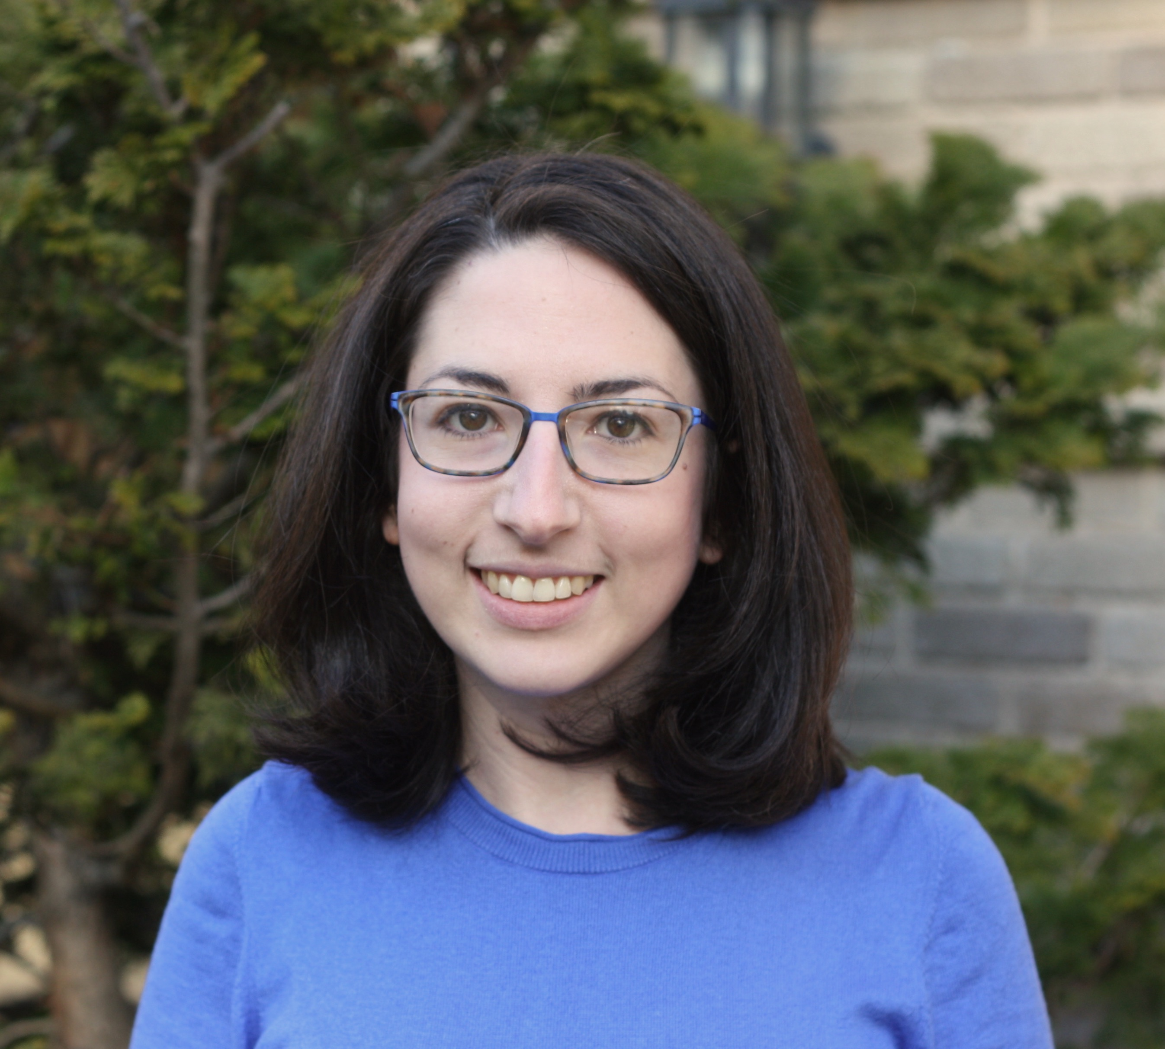
Kyle Rawlins
Johns Hopkins University
Ben Van Durme
Johns Hopkins University
Rachel Rudinger
University of Maryland

Slide 110
Someone was irritated that a particular thing happened.
Veridicality task
Did that thing happen?
no maybe or maybe not yes

Slide 111
NP _ that S
Someone {knew, didn't know} that a particular thing happened.
NP be _ that S
Someone {was, wasn't} surprised that a particular thing happened.
NP _ for NP to VP
Someone {needed, didn’t need} for a particular thing to happen.
NP _ NP to VP[+/-eventive]
Someone {told, didn’t tell} a particular person to do a particular thing.
Someone {believed, didn’t believe} a particular person to have a particular thing.
NP be _ to VP[+/-eventive]
A particular person {was, wasn’t} excited to do a particular thing.
A particular person {was, wasn’t} suspected to have a particular thing.
NP _ to VP[+/-eventive]
A particular person {managed, didn’t manage} to do a particular thing.
A particular person {seemed, didn’t seem} to have a particular thing.

Slide 112

White and Rawlins 2018
r=0.70
Degen and Tonhauser 2018

Slide 113
Belief Task Kane et al. 2024, in prep (see Appendix F)
NP _ S NP believe S
Desire Task Kane et al. 2024, in prep (see Appendix F)
NP _ S NP want S
Intention Task Kane et al. 2024, in prep (see Appendix F)
NP _ S NP intends S
Neg-Raising Task An & White 2020 (see Appendix F)
NP not _ S NP _ not S

Slide 114
Question
Is bleaching a valid method for capturing inferences associated with a verb in a frame?

Slide 115
Validation Strategy #1 see Appendix G
Compare judgments for bleached items against judgments from trained linguists.
Validation Strategy #2 see Appendix H
Compare judgments for bleached items to judgments for more contentful items.
Validation Strategy #3 see Appendix I
Compare inference judgments for bleached items to acceptability judgments for distributional diagnostic.

Slide 116
Semantic Encoding
Discovering Patterns

Slide 117
Approach
Cluster predicate-frame pairs in inference space using a multiview mixed effects mixture model.

Slide 118
yes
Someone didn’t __ that a particular thing happened?
Did that thing happen?
no
yes
Someone __ed that a particular thing happened?
Did that thing happen?
White & Rawlins 2018

Slide 119



Inference +
distribution patterns
know
NP _ S
1
2
3
4
5
6
10
11
7
8
9
12
Acceptability
Neg-raising
5
4
1
3
6
Belief
2
7
Desire
Intention
Veridicality
NP[3s] not _ S
NP_ S
NP _ S
NP _ S
NP _ S
0
1
0
1
0
1
0
1
no
maybe
yes

Slide 120



Inference +
distribution patterns
know
NP _ S
1
2
3
4
5
6
10
11
7
8
9
12
Acceptability
Neg-raising
5
4
1
3
6
Belief
2
7
Desire
Intention
Veridicality
NP[3s] not _ S
NP_ S
NP _ S
NP _ S
NP _ S
0
1
0
1
0
1
0
1
no
maybe
yes

Slide 121
All frames simultaneously!!!
Inference +
distribution patterns
know
1
2
3
4
5
6
10
11
7
8
9
12
Acceptability
Neg-raising
5
4
1
3
6
Belief
2
7
5
4
Desire
1
3
6
Intention
Veridicality
2
7
5
4
1
3
6
2
7
5
4
1
3
6
2
7
5
4
1
3
6
2
7
0
1
0
1
0
1
0
1
no
maybe
yes
0
1
0
1
0
1
0
1
no
maybe
yes
0
1
0
1
0
1
0
1
no
maybe
yes
0
1
0
1
0
1
0
1
no
maybe
yes
0
1
0
1
0
1
0
1
no
maybe
yes

Slide 122
Method
Fit model to all data in MegaAcceptability, MegaVeridicality, MegaNegRaising, and MegaIntensionality using MAP estimation.

Slide 123
Output
A distribution over inference + distribution patterns for each verb.

Slide 124
Inference +
distribution patterns
know
1
2
3
4
5
6
10
11
7
8
9
12
Acceptability
Neg-raising
5
4
1
3
6
Belief
2
7
5
4
Desire
1
3
6
Intention
Veridicality
2
7
5
4
1
3
6
2
7
5
4
1
3
6
2
7
5
4
1
3
6
2
7
0
1
0
1
0
1
0
1
no
maybe
yes
0
1
0
1
0
1
0
1
no
maybe
yes
0
1
0
1
0
1
0
1
no
maybe
yes
0
1
0
1
0
1
0
1
no
maybe
yes
0
1
0
1
0
1
0
1
no
maybe
yes

Slide 125
Output
A distribution over inference + distribution patterns for each verb.
For each inference pattern, distributions over judgments for each frame and inference type.

Slide 126
Inference +
distribution patterns
know
1
2
3
4
5
6
10
11
7
8
9
12
Acceptability
Neg-raising
5
4
1
3
6
Belief
2
7
5
4
Desire
1
3
6
Intention
Veridicality
2
7
5
4
1
3
6
2
7
5
4
1
3
6
2
7
5
4
1
3
6
2
7
0
1
0
1
0
1
0
1
no
maybe
yes
0
1
0
1
0
1
0
1
no
maybe
yes
0
1
0
1
0
1
0
1
no
maybe
yes
0
1
0
1
0
1
0
1
no
maybe
yes
0
1
0
1
0
1
0
1
no
maybe
yes

Slide 127
Question
How many inference patterns should we assume exist?
Idea
Only as many as we need to predict judgments for verb-frame-judgment type tuples we have not observed when fitting the model.

Slide 128
Implementation
Select the smallest clustering for which no larger clustering improves prediction of held-out tuples.

Slide 129

Likelihood of held out data
# of inference + distribution patterns

Slide 130
Implementation
Select the smallest clustering for which no larger clustering improves prediction of held-out tuples.
Idea
Optimal number of inference + distribution patterns is 25.

Slide 131
Likelihood of head out data
# of inference + distribution patterns

Slide 132
Interpretation
There are at least 25 distributionally correlated inference patterns.
Important Point #1
Not all inference + distribution patterns instantiated by particular predicates will get their own inference pattern.
Important Point #2
Enriching the distributional representation or range of inferences could increase the granularity of the patterns.

Slide 133
Semantic Encoding
Analyzing Patterns

Slide 134
Question
Do we observe subclasses that consistently give rise to factive inferences?
Reason
Observing such subclasses, which are constrained to explain distribution, is consistent with factivity being semantically represented.

Slide 135
Inference +
distribution patterns
Which predicates have high probability for a pattern?
know
1
2
3
4
5
6
10
11
7
8
9
12
Acceptability
Neg-raising
5
4
1
3
6
Belief
2
7
5
4
Desire
1
3
6
Intention
Veridicality
2
7
5
4
1
3
6
2
7
5
4
1
3
6
2
7
5
4
1
3
6
2
7
0
1
0
1
0
1
0
1
no
maybe
yes
0
1
0
1
0
1
0
1
no
maybe
yes
0
1
0
1
0
1
0
1
no
maybe
yes
0
1
0
1
0
1
0
1
no
maybe
yes
0
1
0
1
0
1
0
1
no
maybe
yes

Slide 136
What is the expected value of each distribution?
Inference +
distribution patterns
know
1
2
3
4
5
6
10
11
7
8
9
12
Acceptability
Neg-raising
5
4
1
3
6
Belief
2
7
5
4
Desire
1
3
6
Intention
Veridicality
2
7
5
4
1
3
6
2
7
5
4
1
3
6
2
7
5
4
1
3
6
2
7
0
1
0
1
0
1
0
1
no
maybe
yes
0
1
0
1
0
1
0
1
no
maybe
yes
0
1
0
1
0
1
0
1
no
maybe
yes
0
1
0
1
0
1
0
1
no
maybe
yes
0
1
0
1
0
1
0
1
no
maybe
yes

Slide 137
Names given by analyst based on manual analysis!
Inference +
distribution patterns
know
1
2
3
4
5
6
10
11
7
8
9
12
Acceptability
Neg-raising
5
4
1
3
6
Belief
2
7
5
4
Desire
1
3
6
Intention
Veridicality
2
7
5
4
1
3
6
2
7
5
4
1
3
6
2
7
5
4
1
3
6
2
7
0
1
0
1
0
1
0
1
no
maybe
yes
0
1
0
1
0
1
0
1
no
maybe
yes
0
1
0
1
0
1
0
1
no
maybe
yes
0
1
0
1
0
1
0
1
no
maybe
yes
0
1
0
1
0
1
0
1
no
maybe
yes

Slide 138

Purely for exposition!
Derived by hierarchical clustering based on expected value of inference distributions.

Slide 139
Plan
Walk through some classes we might expect and show that they look exactly like we would expect them to.

Slide 140
discover, realize, recognize, know, find out, understand, …

Slide 142
discovered
realized
recognized
knew
…
Someone that a particular thing happened.
That thing happened.

Slide 143
discover
realize
recognize
know
…
Someone didn’t that a particular thing happened.
That thing happened.

Slide 145


Slide 146
discovered
realized
recognized
knew
…
Someone that something happened.

Slide 147
discovered
realized
recognized
knew
…
*Someone was that something happened.

Slide 148
dream, hope, think, agree, assume, …

Slide 149
dreamed hoped
thought assumed
…
Someone (*was) that something happened.

Slide 150
dream
hope
think assume
…
Someone did(n’t) that a particular thing happened.
x
That thing happened.

Slide 151

discovered
realized
recognized
knew
…
A that C happened.
A believed that C happened.

Slide 152
discover
realize
recognize
know
…
A didn’t that C happened.
x
A believed that C happened.

Slide 153
dreamed
hoped
thought assumed
…
A that C happened.
A believed that C happened.

Slide 154
be contented, be relieved, be amused, be charmed, be pleased, be comforted, …

Slide 155
pleased
relieved
amused
charmed
…
Someone was(n’t) that a particular thing happened.
That thing happened.

Slide 156
pleased
relieved
amused
charmed
…
A was(n’t) that C happened.
A believed that C happened.

Slide 157

pleased
relieved
amused
charmed
…
A was that C happened.
A wanted C to have happened.

Slide 158
pleased
relieved
amused
charmed
…
A wasn’t that C happened.
x
A wanted C to have happened.

Slide 159
Upshot
We observe classes that recapitulate part of the standard classification of clause-embedding predicates.

Slide 160
Interim Discussion

Slide 161
Question
If we develop a model that accounts for measurement noise and the possibility of multiple subclasses, are factive inferences correlated with distribution?
Answer
Yes.

Slide 162
Upshot
This correlation is consistent with the drivers of factive inferences being semantically represented.

Slide 163
Conventional + Conversational
Purely Conversational
Ambiguity
Resolved Uncertainty
Uncertainty across multiple distinct semantic values for an expression that have different preconditions of use.
Uncertainty across possible discrete states of a discourse that is resolved as a matter of integrating an utterance.
Uncertainty about the preconditions of use inherent to a single semantic value for an expression evoked on every use.
Vagueness
Uncertainty across possible discrete states of a discourse that is not resolved as a matter of integrating an utterance.
Unresolved Uncertainty

Slide 164
Important Point #1
The relationship between the semantic drivers and the factive inferences may be indirect.

Slide 165
Cognitive Nonfactives
Cognitive Semifactives
Positive Emotive Factives
thinks
suspects
knows
realized
loves
likes
A believes that B happened.
A believes that B happened.
A believes that B happened.
B happened.
A believes that B happened.
A wants B to have happened.
think
suspect
know
realize
love
like
A doesn’t believes that B happened.
A doesn’t believes that B happened.
A doesn’t believes that B happened.

Slide 166
Positive Emotive Factives
loves
likes
A believes that B happened.
B happened.
A believes that B happened.
A wants B to have happened.
love
like
A doesn’t believes that B happened.

Slide 167
Positive Emotive Factives
loves
likes
A believes that B happened.
Default credence inference?
Heim 1992, Djarv et al. 2018
B happened.
A believes that B happened.
A wants B to have happened.
Still a lexically encoded precondition of use!
love
like
A doesn’t believes that B happened.

Slide 168
Important Point #1
The relationship between the semantic drivers and the factive inferences may be indirect.
Important Point #2
The information the predicate provides may be purely formal–e.g. predicates may select morphemes that themselves drive factive inferences.

Slide 169







Factivity is strongly linked with a variety of morphemes that mediate the relationship between the embedding predicate and the embedded clause!
among others…

Slide 170
Important Point #3
Purely contextual account may still be possible, but it should explain why the distributional correlations exists.
see Roberts and Simons 2024
Important Point #4
As always, we still need a pragmatic story for how we determine what linguistic expression is being used.

Slide 171
Conclusion

Slide 172
Big Question
What kinds of things do we know when we know the meaning (broadly construed) of a linguistic expression?

Slide 173
One Kind of Knowledge
How the expression can move a conversation forward when used in a particular way.
???
Another Kind of Knowledge
How the conversation has to look for it to even make sense to use the expression.

Slide 174
This Talk
Expressions carry information about preconditions of use in their semantics.
Open class items are (at least part of) the locus of this information.

Slide 175
Question
Why would we see predicates semantically (or at least distributionally) encoding their preconditions of use?
Possible Answer
It might be very hard to learn these preconditions otherwise.

Slide 176

Simply tracking the discourse status of the embedded clause content is unlikely to work!

Slide 177
Thanks!

Slide 178

Supported by NSF-BCS-1748969
The MegaAttitude Project: Investigating selection and polysemy at the scale of the lexicon

Slide 179
Appendix A
Posterior distributions

Slide 180

Posterior distribution of mean response

Slide 181
Appendix B
Prompt manipulation

Slide 182
Question #3
Does the prompt encourage participants to “respond more discretely” because the prompt is a polar question?

Slide 184
Question #3
Does the prompt encourage participants to “respond more discretely” because the prompt is a polar question?
Approach
Modify the prompt to query for the level of likelihood or certainty the speaker has.

Slide 186


Slide 190


Slide 191
Appendix C
Content manipulation

Slide 192
Question #4
Do contents biased for high or likelihood cause people to “respond more discretely”?
Approach
Remove the possibility that people can rely on prior beliefs by bleaching the content of the sentence.

Slide 193


Slide 194


Slide 195


Bleached
Templatic

Slide 196


Slide 197
Appendix D
Acceptability Validation #1

Slide 198
Validation data
Select 30 verbs from across Hacquard & Wellwood's (2012) classification
Gather judgments for these verbs in all 50 syntactic frames from:
trained linguists
naïve speakers

Slide 199
Comparison
Correlation between judgments from LI and Sprouse et al.'s (2013) dataset

Slide 200

Correlation
Sprouse Linguistic Inquiry
MegaAcceptability

Slide 201
Appendix E
Acceptability Validation #2

Slide 202
Case Study The vast majority of about-PPs are adjuncts.
Rawlins 2013, 2014

Slide 203
XP₁ V (XP₂) (XP₃) about XP₄
is acceptable
X
XP₁ V (XP₂) (XP₃)
is acceptable

Slide 204


NP _ed about XP
NP _ed

Slide 205

Rawlins 2014

Slide 206

NP _ed about XP
NP _ed

Slide 207

NP _ed about XP
NP _ed

Slide 208

NP _ed about XP
NP _ed

Slide 209

NP _ed about XP
NP _ed

Slide 210

NP _ed about XP
NP _ed

Slide 211

NP _ed about XP
NP _ed

Slide 212

Independence
Proportion violations
Noise variance / acceptability variance

Slide 213
Independence
Proportion violations
Noise variance / acceptability variance

Slide 214

NP (was) _ed about whether S
NP (was) _ed

Slide 215

NP (was) _ed about whether S
NP (was) _ed

Slide 216

NP (was) _ed about whether S
NP (was) _ed

Slide 217

NP (was) _ed about whether S
NP (was) _ed

Slide 218

Proportion violations
Acceptability threshold

Slide 219
Independence
Proportion violations
Noise variance / acceptability variance

Slide 220
Proportion violations
Acceptability threshold

Slide 221
Proportion violations
Acceptability threshold

Slide 222
Appendix F
Additional Tasks

Slide 223
Belief task

Slide 224
Ben Kane
OpenStream.AI
Will Gantt
Johns Hopkins University

Slide 225
If A knew that C happened, how likely is it that A believed that C happened?
Belief task
Extremely unlikely
Extremely likely

Slide 226
If A persuaded B that C happened, how likely is it that B believed that C happened?
Belief task
Extremely unlikely
Extremely likely

Slide 227
If A was appalled that C happened, how likely is it that A wanted C to have happened?
Desire task
Extremely unlikely
Extremely likely

Slide 228
If A apologized to B that C happened, how likely is it that B wanted C to have happened?
Desire task
Extremely unlikely
Extremely likely

Slide 229
NP _ that S
A {knew, didn't know} that C happened.
NP _ NP that S
A {told, didn't tell} B that C happened.
NP _ to NP that S
A {said, didn't say} to B that C happened.
NP _ that S
A {was, wasn’t} surprised that C happened.
NP _ that S[+future]
A {hoped, didn't hope} that C would happen.
NP _ NP that S[+future]
A {promised, didn't promise} B that C would happen.
NP _ to NP that S[+future]
A {predicted, didn't predict} to B that C would happen.
NP _ that S[+future]
A {was, wasn’t} excited that C would happen.

Slide 230
In preparation!
Ben Kane
OpenStream.AI
Will Gantt
Johns Hopkins University

Slide 231
NP _ for NP to VP
A {wanted, didn’t want} for B to do C.
NP _ to VP[+/-eventive]
A {hoped, didn’t hope} to {do, have} C.
NP _ NP to VP[+/-eventive]
A {told, didn't tell} B to {do, have} C.
NP _ to NP to VP[+/-eventive]
A {said, didn't say} to B to {do, have} C.
NP be _ to VP[+/-eventive]
A {was, wasn’t} believed to {do, have} C.
NP _ NP VP
A {saw, didn’t see} B do C.
NP _ VPing
A {liked, didn’t like} doing C.

Slide 232
If A chose to do C, how likely is it that A intended to do C?
Intention task
Extremely unlikely
Extremely likely

Slide 233


Hannah An
University of Rochester

Slide 234
Neg-raising task

Slide 235
If I were to say I don’t think that a particular thing happened, how likely is it that I mean I think that that thing didn’t happen?
Neg-raising task
Extremely unlikely
Extremely likely

Slide 236
NP _ that S
I {didn’t, don’t}
know that a particular thing happened.
A particular person {didn’t, doesn’t}
NP be _ that S
I {wasn’t, ‘m not}
surprised that a particular thing happened.
A particular person {wasn’t, isn’t}
NP be _ to VP[+/-eventive]
I {wasn’t, ‘m not}
told to do a particular thing.
A particular person {wasn’t, isn’t}
believed to have a particular thing.
NP _ to VP[+/-eventive]
I {didn’t, don’t}
managed to do a particular thing.
A particular person {didn’t, doesn’t}
seemed to have a particular thing.

Slide 237
Appendix G
Inference Validation #1

Slide 238
 | Neg-raising | Non-neg-raising
NP __ that S | think, believe, feel, reckon, figure, guess, suppose, imagine | announce, claim, assert, report, know, realize, notice, find out
NP __ to VP | want, wish, happen, seem, plan, intend, mean, turn out | love, hate, need, continue, try, like, desire, decide

Slide 239


Mean rating of bleached example
Non-neg-raising
Neg-raising

Slide 240
Appendix H
Inference Validation #2

Slide 241
Implementation
For each verb-frame pair in validation set, sample five items from corpus.

Slide 242

Mean rating of bleached example
r = 0.8
(p < 0.001)
Mean rating of corpus example

Slide 243
Appendix I
Inference Validation #3

Slide 244
Implementation
For each verb-frame pair in validation set, collect acceptability of strong NPI (additive either).
Jo didn’t do a particular thing, and…
…I don’t think that Bo did that thing either.
…I think that Bo didn’t do that thing either.

Slide 245

Mean acceptability of strong NPI
r = 0.77
(p < 0.001)
Mean rating of bleached example

Slide 246
Appendix J
Inference Validation #3

Slide 247
Implementation
For each verb-frame pair in validation set, collect acceptability of strong NPI (additive either).
Jo didn’t do a particular thing, and…
…I don’t think that Bo did that thing either.
…I think that Bo didn’t do that thing either.

Slide 248
Mean acceptability of strong NPI
r = 0.77
(p < 0.001)
Mean rating of bleached example

Slide 249
Appendix K
Predicates in each class

Slide 250
glare, grin, strut, talk, beam, frown, scowl, sulk, …

Slide 251
hound, pester, educate, interview, badger, brief, bug, challenge, …

Slide 252
bury, come, function, happen, invite, result, …

Slide 253
inform, remind, tell, advise, alert, ask, email, notify, warn, …

Slide 254
audit, discipline, approach, chastise, compliment, praise, demean, …

Slide 255
be fazed, be clouded, be gladdened, be affronted, be bored, be blessed, chide, …

Slide 256
defend, imitate, portray, address, conceal, depict, describe, detail, …

Slide 257
buy, delete, alter, attempt, insert, operate, cause, …

Slide 258
coerce, enlist, manipulate, allow, assign, bribe, coax, compel, force, …

Slide 259
articulate, communicate, explain, write, …

Slide 260
affirm, confirm, verify, acknowledge, clarify, …

Slide 261
be contented, be relieved, be amused, be charmed, be pleased, be comforted, …

Slide 262
check, investigate, contemplate, evaluate, examine, explore, …

Slide 263
aim, appear, compete, hunger, try, lust, attempt, start, …

Slide 264
expect, authorize, desire, request, allow, approve, …

Slide 265
dream, hope, think, agree, assume, …

Slide 266
discover, realize, recognize, know, find out, understand, …

Slide 267
manage, glean, opt, presuppose, signify, conclude, …

Slide 268
apologize, complain, cry, gloat, growl, sob, weep, …

Slide 269
(be) depress(ed), (be) disappoint(ed), (be) shock(ed), (be) disgust(ed), (be) displease(ed), (be) embarrass(ed), (be) frustrate(ed), (be) surprise(ed), …

Slide 270
confuse, distress, freak out, panic, perplex, puzzle, stump, baffle, …

Slide 271
fret, lie, agonize, bitch, brood, object, quarrel, quibble, whine, …

Slide 272
decline, fail, hate, neglect, refuse, regret, detest, dislike, …

Slide 273
denounce, disallow, face, prohibit, repress, abhor, admonish, …

Slide 274
doubt, question, dispute, fear, neglect, worry, …

Slide 275
Appendix L
Class-frame relationship

Slide 276
Simple past matrix

Slide 277

Simple present matrix

Slide 278
Past progressive matrix

Slide 279
Appendix M
Class-constituent relationship

Slide 280


Slide 281
Appendix N
Class-inference relationships

Slide 287
Appendix O
Class-primitive relationships

Slide 288


Slide 289
Appendix P
Primitive-constituent relationships

